Slide 1
Thermochemistry The study of energy
Chapter 6/ 16
Chapter 8 in AP book

Slide 2
6. 1 The Nature of Energy
Energy is capacity to do work or to produce heat.
Thermochemistry is the relationship between chemical reactions and energy changes.

Slide 3
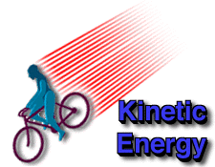
Kinetic Energy
The energy of an object in motion
Examples:
Velocity, heat
Temp = Heat

Slide 4
Stored energy in an object by virtue of its position.
Units of energy:
Joule J,
1 Calorie Cal = 4.184 J

Slide 5
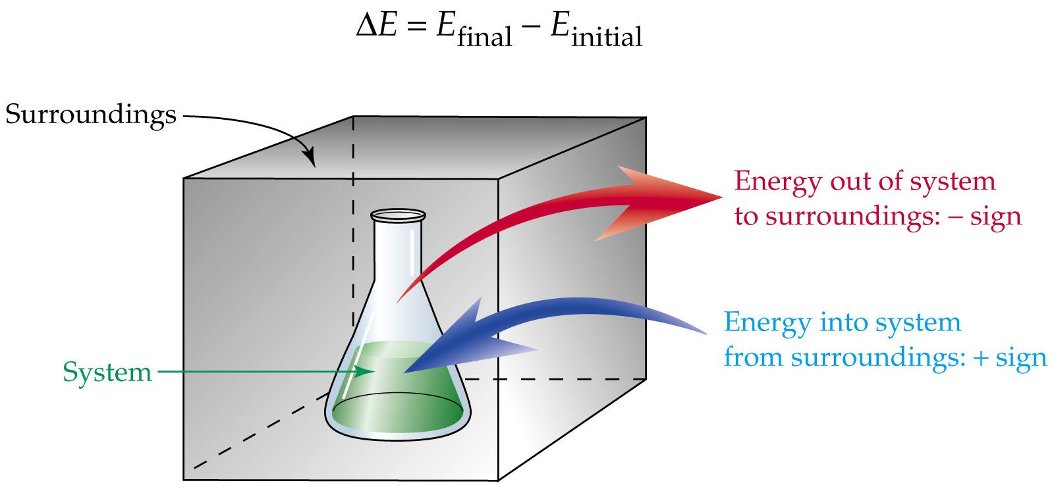
Energy Systems
System: portion we single out to study
Ex: reactants products.
Surroundings:
reaction vessel

Slide 6
Types of Systems

Slide 7
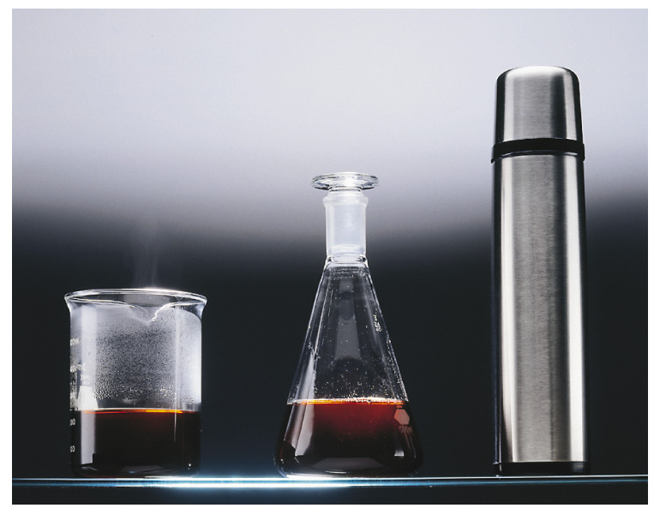

Slide 8
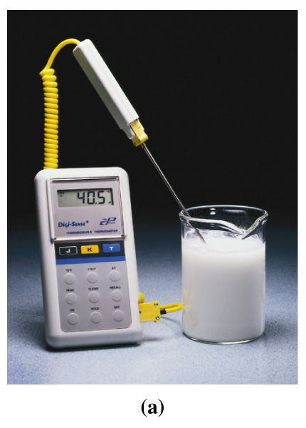
Exothermic
A reaction that results in the evolution of heat. Thus heat flows out of the system
Exo = out
- q = (- heat )

Slide 9
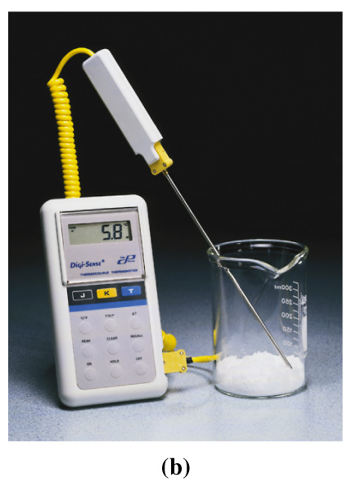
Endothermic
A reaction that absorbs heat from their surroundings. Thus heat flows into a system.
Endo = In to
+ q = (+ heat )

Slide 10
First law of thermodynamics
Aka: The law of conservation of energy
Energy is neither created nor destroyed, thus energy is converted from one form to another.

Slide 11
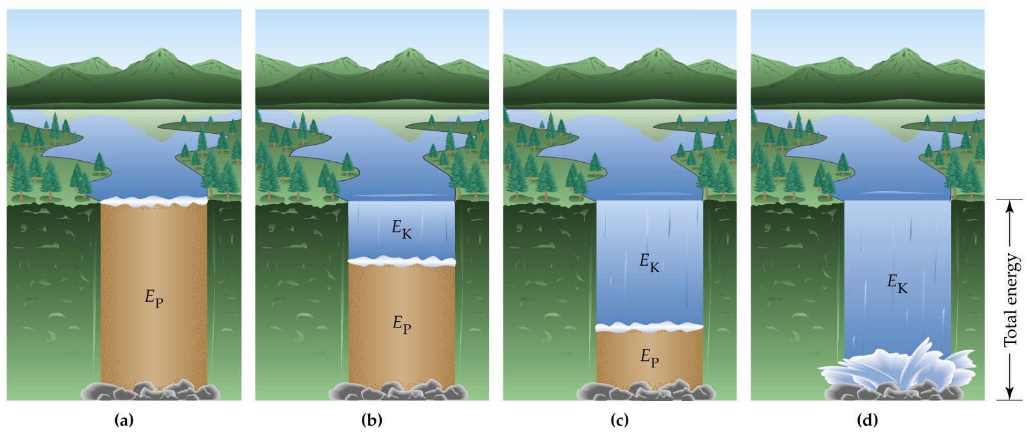
The total amount of energy contained by the water in a reservoir is constant.
A. At the top of the dam, the energy is potential (EP).
B-C. As the water falls over the dam, its velocity increases, and potential energy is converted into kinetic energy (EK).
D. At the bottom of the dam, the kinetic energy gained by the water is largely converted into heat and sound as the water dashes against the rocks.

Slide 12
1st Law of Thermodynamics
The energy of the universe is constant
Universe = System + Surroundings

Slide 13
Internal Energy
The energy (E) of a system can be defined as the sum of the kinetic and potential energies of all of the particles in a system.
Internal energy can be changed by a flow of HEAT, WORK, or BOTH

Slide 14
Equation of the 1st Law of Thermodynamics
ΔE = q + w
ΔE = change in system’s internal energy
q = heat
w = work

Slide 15
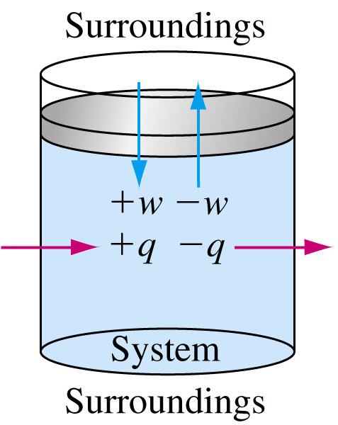

Slide 16
ΔE = E_{f} - E₁
ΔE > 0 = system gained energy
ΔE < 0 = system lost energy to the surroundings
Energy!!!

Slide 17
Work (w)
W > 0 = work is done ON the system
( + W)
W < 0 = work is done BY the system on the surroundings.
(-W)

Slide 18
Heat (q)
q > 0 = heat is added to the system. (+ q endothermic)
q < 0 = heat is released from the system (-q exothermic)

Slide 19
Example:
Calculate ΔE for a system undergoing and endothermic process in which 15.6 kJ of heat flows and where 1.4 kJ of work is done by the system.

Slide 20
Answer
q = + 15.6 (endothermic)
W = - 1.4 kJ (work is done by the system)
ΔE = 15.6 - 1.4 = 14.2

Slide 21
AP Example

Slide 23
State Function
A Property of a function that is determined by specifying its condition or its present state
Same thing different wording:
(A property of a system that is not dependent on the way in which the system gets to the state in which it exhibits that property.) (i.e we only care about the net change. )
The value of a state function depends only on the present state of the system - not how it arrived there
Energy E, Enthalpy H, Entropy S, Free Energy change G are all state functions.

Slide 24
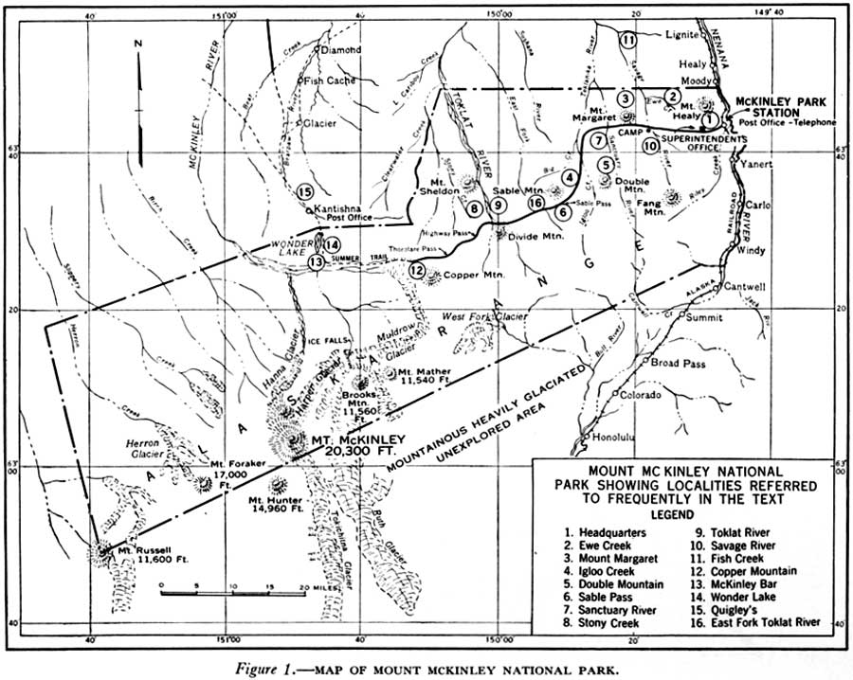
Example
It does not matter if I approach from the North or from the South. I will have and endpoint to my destination of Mt. McKinley.

Slide 25
Example
It does not matter whether I heated the water or cooled that water to get it to the temperature. Internal energy (of the center beaker) would be the same regardless.

Slide 26
Change in energy ΔE
ΔE is a state function because it is independent of pathway.
(all we care about is energy at E_{i} and energy at E_{f.} at a given time or temperature)

Slide 27
Dead Give away
http://www.cord.edu/faculty/ulnessd/legacy/fall99/sarah/sld001.htm

Slide 28
Change in energy ΔE
ΔE is a state function because it is independent of pathway.
(all we care about is energy at E_{i} and energy at E_{f.}
Heat (q) and work (w) are not state functions!!!!!

Slide 29
Calculating Work (w)
work = force × distance
since pressure = force / area,
work = pressure × volume
w_{system} = −PΔV
Note: P = pressure of the external environment.
Know: 101.3 J/L*atm

Slide 30
Example:
Calculate the work associated with the expansion of gas form 46 L to 64 L at a constant external pressure of 15 atm.

Slide 31
Answer
w = -PΔV
P = 15 atm
V = 64-46 = 18L
w = -15(18)
= -270 L*atm

Slide 32
Homework
Pg 282-283 #’s 21-24 all

Slide 33
6.2 Enthalpy and Calorimetry
Enthalpy (H):
The measure of energy that is released or absorbed by the substance when bonds are broken and formed during reactions
Bonds formed = energy release (EXO)
Bonds Broken = energy absorbed (ENDO)

Slide 34
Enthalpy Change H°
This change takes place over the course of a reaction and shows the net overall change.
ΔH = H _{products} – H _{reactants}

Slide 35
Where to Find ΔValues
Table 6.0 pg 262
Appendix pg A21-22

Slide 36
More enthalpy
Enthalpy, along with the pressure and volume of a system, is a state function (property of a system that depends only on its state, not how it arrived at its present state).

Slide 37
Heat Of Formation H_{rxn} = H (products) – H (reactants)
ΔH°_{f} = H (products) – H (reactants)
ΔH°_{f} > 0 = energy is absorbed
product is less stable
endothermic process
ΔH°_{f} < 0 = energy is released
product is more stable
exothermic process

Slide 38
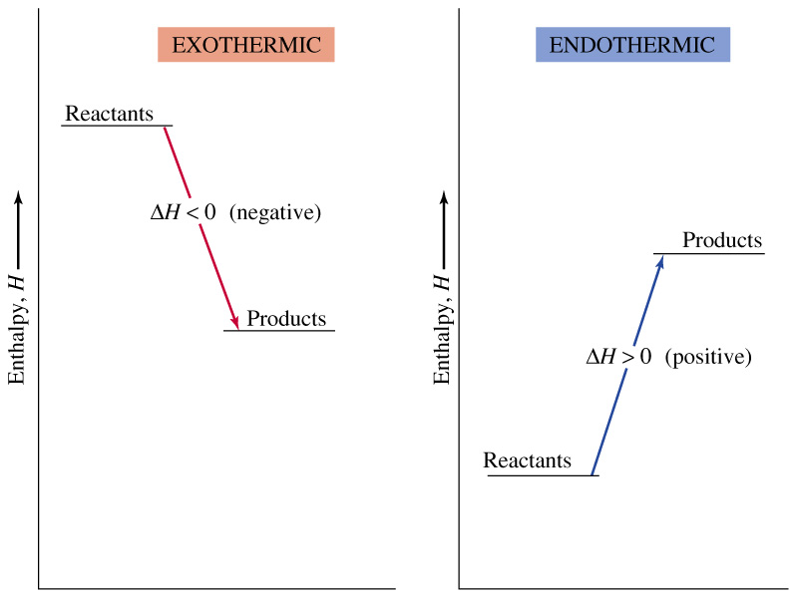
Products have stronger bonds than reactants and have lower enthalpy than reactants and are more stable.
**low enthalpy means more stable.

Slide 39
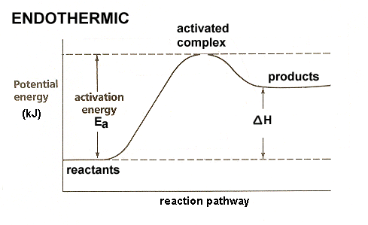
All reactant bonds broken no products formed
the reactants have less potential energy than the products. Energy must be input in order to raise the particles up to the higher energy level.
Energy + A + B --> AB

Slide 40
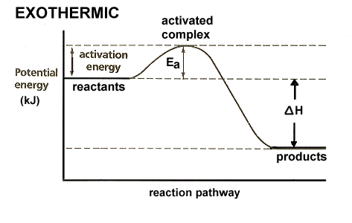
The reactants have more potential energy than the products have. The extra energy is released to the surroundings.
A + B --> AB + Energy

Slide 41
Uncatalyzed
catalyzed
Catalysts speed up reactions by providing an alternate pathway for the rxn to occur. Note that energy of reactants, products, and ∆H are the same but activation energy E_{a} is just lower.

Slide 42
Example:
Using enthalpies of formation, calculate the standard change in enthalpy for the following reaction. Then determine if the reaction is endothermic or exothermic:
2Al (s) + Fe₂O₃ (s) → Al₂O₃ (s) + 2Fe (s)

Slide 43
ΔH_{rxn} = H (products) – H (reactants)
2Al (s) + Fe₂O₃ (s) → Al₂O₃ (s) + 2Fe (s)
H = 0 + -826 -1676 + 0
(-1676 + 0) - (0 + -826)
ΔH_{rxn} = -850 kJ VERY exothermic

Slide 44
Homework
Pg 285 #’s 61, 64, 65,

Slide 45
More Equations
At Constant Pressure:
ΔH = q_{p}
At constant volume:
ΔΕ = q_{v}

Slide 46
Calorimetry
Measures heat flow
Calorimeter: used to measure the exchange of heat that accompanies chemical reactions.

Slide 47
How it works
Reaction using known quantities of reactants is conducted in an insulated vessel that is submerge in a known qty of water.
The heat created from the reaction will increase the temperature of the water surrounding the vessel.
The amount of heat emitted can be calculated using the total heat capacity of the calorimeter and its contents.

Slide 48
Heat Capacity
The heat required to raise the temperature of a substance by 1ºC
q = CΔT
q = heat energy released or absorbed by the rxn
C = heat capacity
ΔT = change in temperature in ºC

Slide 49
Specific Heat
The heat required to raise 1 gram of a substance by 1ºC
q = sm ΔT
q= heat energy released or absorbed by the rxn
S = specific heat
m = mass of solution
ΔT = change in temperature in ºC

Slide 50
Example:
How much heat in kJ is required to increase the temperature if 150 g of water from 25°C to 42°C. Sp heat of water is 4.18 J/g°C. (Memorize sp heat water)

Slide 51
Answer
q = msΔT
q = 150(4.18)(42-25)
q = 10,659 j
q = 10.659 kJ

Slide 52
A coffee cup calorimeter initially contains 125 g of water at 24.2°C. Potassium bromide (10.5g) also at 24.2°C is added to the water, and after the KBr dissolves, the final temp is 21.1°C. Calculate the enthalpy change for dissolving the salt in J/g and kJ/mol. Assume that the specific heat capacity of the solution is 4.184 J/°Cg and that no heat transferred to the surroundings or to the calorimeter.

Slide 53
q = msΔT (think m total)
m = 125 + 10.5 = 135.5
q= 135.5 (4.184)(24.2-21.1)
q = 1755.8 J
ΔH = q
ΔH = 1755.8 119gKBr 0.001kJ
10.5g KBr 1 mol 1J
= 19.9 kJ/mol

Slide 54
Example
A 42.2 g sample of copper is heated to 95.4 ºC and then placed into a calorimeter containing 75.0 g of water at 19.6 ºC. The final temp of the metal and water was 21.8 ºC. Calculate the specific heat of copper, assuming that all the heat lost by copper is gained by water.

Slide 55
Assume Heat lost = heat gained
q_{lost} = 42.2g(s)(95.4-21.8 ºC )
= 3400.32(s)
q_{gained} = 75.0 g(4.18)(21.8-19.6 ºC )
= 689.7
3400.32(s) = 689.7
S = 0.2 J/ºC *g

Slide 56
Homework
Pg 283 #’s: 21, 23, 25, 28
31,38,41,47

Slide 57
6.3 Hess’s Law
“Heat of summation”
states that if reactions are carried out in a series of steps, ΔH for the reaction will be equal to the sum of the enthalpy changes by the individual steps.

Slide 58
Reactants → Products
The change in enthalpy is the same whether the reaction takes place in one step or a series of steps.
Goal: manipulate the steps of the equation (multiple, reverse) to cancel out terms to isolate the final reaction and calculate the new enthalpy (ΔH )

Slide 59
Calculations via Hess’s Law
1. If a reaction is reversed, ΔH is also reversed.
N₂(g) + O₂(g) → 2NO(g) ΔH = 180 kJ
2NO(g) → N₂(g) + O₂(g) ΔH = −180 kJ
2. If the coefficients of a reaction are multiplied by an integer, ΔH is multiplied by that same integer.
6NO(g) → 3N₂(g) + 3O₂(g) ΔH = −540 kJ

Slide 60
Solving Hess’s Law Problems
Given the following data, calculate the ΔH for the reaction:
C₂H₂ (g)+ 5/2 O₂ → 2CO₂ (g) + H₂O (l) ΔH = -1300kJ
C (s) + O₂ (g) → CO₂ (g) ΔH = -394 kJ
H₂ (g) + ½ O₂ (g) → H₂O (l) ΔH = -286 kJ
2C (s) + H₂ (g) → C₂H₂ (g)

Slide 61
C₂H₂ (g)+ 5/2 O₂ → 2CO₂ (g) + H₂O (l) ΔH = -1300kJ
C (s) + O₂ (g) → CO₂ (g) ΔH = -394 kJ
H₂ (g) + ½ O₂ (g) → H₂O (l) ΔH = -286 kJ
__________________________________
2C (s) + H₂ (g) → C₂H₂ (g) ΔH =

Slide 63
H₂S(g) + 2O₂(g) → H₂SO₄(l) ΔH =-706.5KJ
H₂SO₄(l) → SO₃(g) + H₂O(g) ΔH =184.5KJ
H₂O(g) → H₂O(l) ΔH=-99KJ
_______________________________________
SO₃(g) + H₂O(l) → H₂S(g) + 2O₂(g) ΔH=

Slide 64
Homework
53, 55, 56, 58
Show all work.

Slide 65
Second Law of Thermodynamics
Is a process is spontaneous in one direction, then it can’t be spontaneous in the reverse.
The entropy (S) of the universe (unlike energy) is always increasing during contentious reactions.

Slide 66
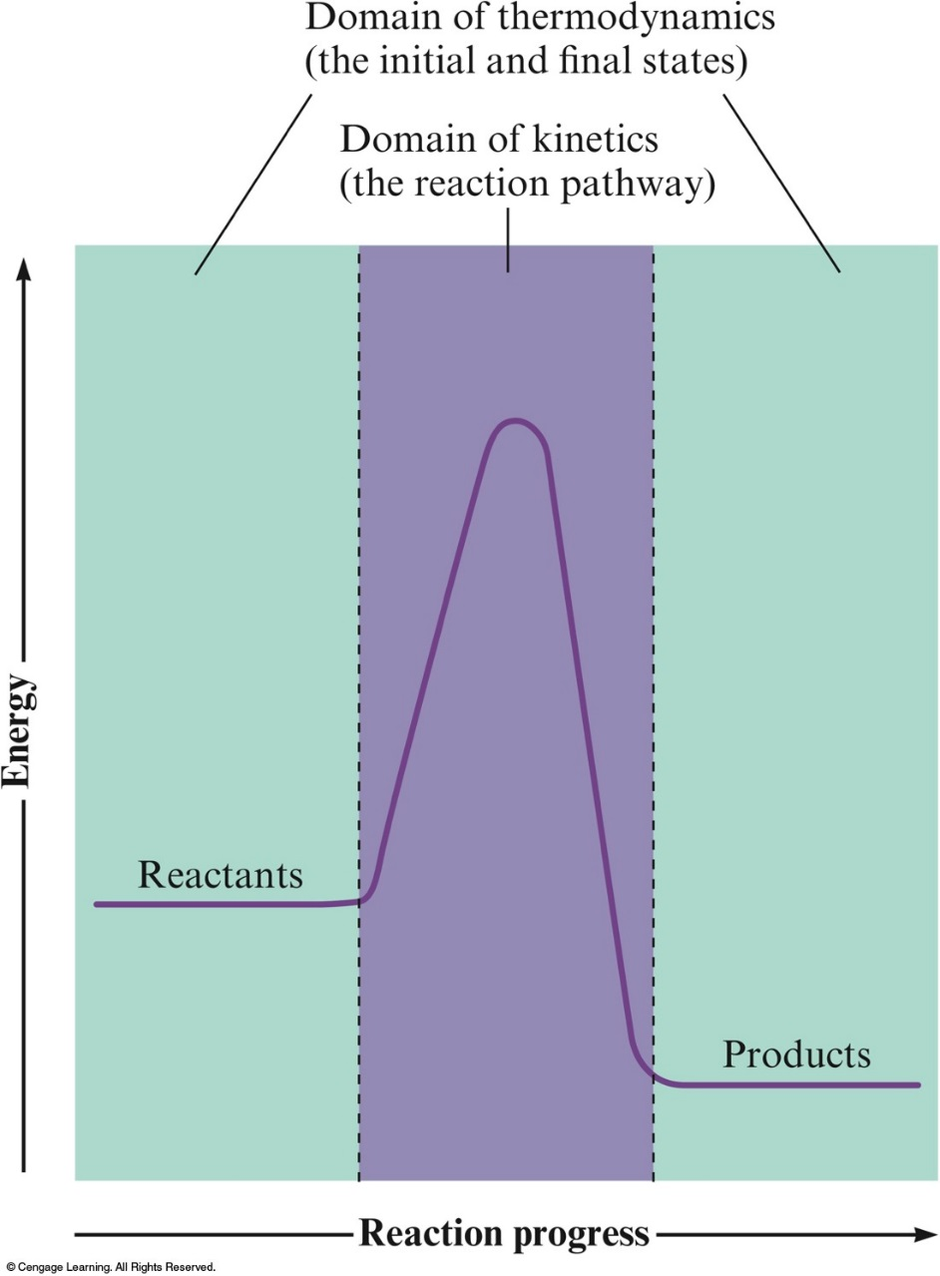
Thermodynamics vs. Kinetics
Domain of Kinetics
Rate of a reaction depends on the pathway from reactants to products.
Thermodynamics tells us whether a reaction is spontaneous based only on the properties of reactants and products.

Slide 67
Spontaneous Processes and Entropy
Thermodynamics lets us predict the direction in which a process will occur but gives no information about the speed of the process.
A spontaneous process is one that occurs without outside intervention.

Slide 68
CONCEPT CHECK!
Consider 2.4 moles of a gas contained in a 4.0 L bulb at a constant temperature of 32°C. This bulb is connected by a valve to an evacuated 20.0 L bulb. Assume the temperature is constant.
What should happen to the gas when you open the valve?
Notes:
The gas should spread evenly throughout the two bulbs.

Slide 69
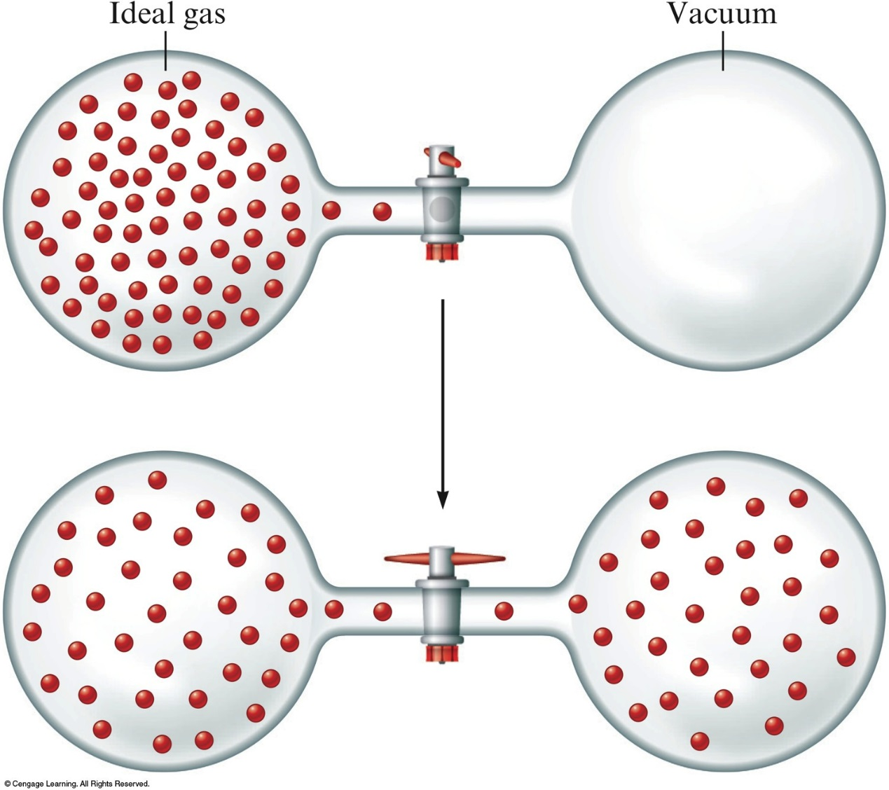
The Expansion of An Ideal Gas Into an Evacuated Bulb

Slide 70
CONCEPT CHECK!
Consider 2.4 moles of a gas contained in a 4.0 L bulb at a constant temperature of 32°C. This bulb is connected by a valve to an evacuated 20.0 L bulb. Assume the temperature is constant.
Calculate ΔH, ΔE, q, and w for the process you described above.
All are equal to zero.
Notes:
All are equal to zero. Since it is a constant temperature process, ΔH = 0 and ΔE = 0. The gas is working against zero pressure (evacuated bulb) so w = 0. ΔE = q + w, so q = 0.

Slide 71
CONCEPT CHECK!
Consider 2.4 moles of a gas contained in a 4.0 L bulb at a constant temperature of 32°C. This bulb is connected by a valve to an evacuated 20.0 L bulb. Assume the temperature is constant.
c) Given your answer to part b, what is the driving force for the process?
Entropy
Notes:
Some students are probably aware of the concept of entropy. This is a good introduction to the concept.

Slide 72
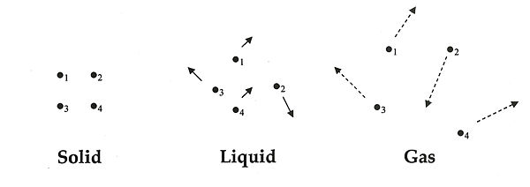
Entropy S
Measures the randomness or disorder of the system.
The greater the disorder the greater the entropy.
<
<

Slide 73
Increasing S
The greatest increase in entropy (randomness) means ∆S is the most positive ( +) and molecules are spazy!
∆S +
The greatest decrease in entropy (randomness) means ∆S negative (-) and molecule are calm cool and collected!
∆S -

Slide 74
Entropy
The driving force for a spontaneous process is an increase in the entropy of the universe.
A measure of molecular randomness or disorder.

Slide 75
Temperature and Entropy
mole 25◦C < 1 mole 50 ◦C < 1 mole 100◦C
(s) (s) (s)
Increasing Entropy

Slide 76
Gauging S in reactions
Compare moles of disorderly reactants to products. The one with the least disorderly products wins.
2C (s) + N₂ (g) → 2CN (g)
2 mol (s) + 1 mol (g) → 2 mole (g) ↑ More disorder
F₂ (g) → F₂ (l)
1 mol (g) → 1 mol (l) ↓ less disorder
H₂O (l) (25◦C) → H₂O (l) (50◦C)
1 mol (l) low energy → 1 mol (l) high energy ↑ more disorder

Slide 77
CONCEPT CHECK!
Predict the sign of ΔS for each of the following, and explain:
The evaporation of alcohol
The freezing of water
Compressing an ideal gas at constant temperature
Heating an ideal gas at constant pressure
Dissolving NaCl in water
+
–
–
+
+
Notes:
a) + (a liquid is turning into a gas)
b) - (more order in a solid than a liquid)
c) - (the volume of the container is decreasing)
d) + (the volume of the container is increasing)
e) + (there is less order as the salt dissociates and spreads throughout the water)

Slide 78
Entropy Change S°
Takes place at the end of the reaction. When we compare the disorder of the reactants to the disorder of the products.
Δ S° = Σ S _{products} – Σ S _{reactants}

Slide 79
Gibbs Free Energy
Free energy of a process and is a measure of the spontaneity of the process.
∆G | - | Rxn is spontaneous K >1
∆G | + | Rxn is Not spontaneous K<1
∆G | 0 | Rxn is at equilibrium (K = 1)

Slide 80
∆G = free energy change
Can be calculated from the free energy’s of formation ∆G_{f}
Δ G° = Σ G_{f} ° _{products} – Σ G_{f} ° _{reactants}

Slide 81
Free energy and equilibrium
G°= -RT ln K or = -2.303 RT Log K
G° = Standard free energy change (J)
R= 8.31 J/mol-K
T= Temp (K)
K = equilibrium constant
(If -G = K>1 products favor equilibrium)
(if +G = K< 1 reactants favor equilibrium)

Slide 82
Bring it all together ∆G ∆H ∆S
Nature prefers low energy (∆H ) high disorder (∆S) spontaneous states (∆G ).
∆G° = ∆H ° - T ∆S ° (T = in K)

Slide 83
∆H Enthalpy | ∆S Entropy | T | ∆G Free Energy | Spontaneity
- | + | Low High | - - | Always spontaneous
+ | - | Low High | + + | Never spontaneous
+ | + | Low High | + - | Not spon. at low T Spon. at high T
- | - | Low High | - + | Spon. At low T Not spon. At high T

