Slide 1
Chapter 11
Properties of Solutions
Chapter 9 in PR
9/75 M.C questions Appears almost every year in free response section

Slide 2
The Solution Process
Solutions are formed when a substance disappears uniformly throughout another substance.
When NaCl is added to water the water molecules orient themselves on the surfae of the NaCl

Slide 3
Solvation… (no not like at church)
The clustering of molecules around the solute particle

Slide 4
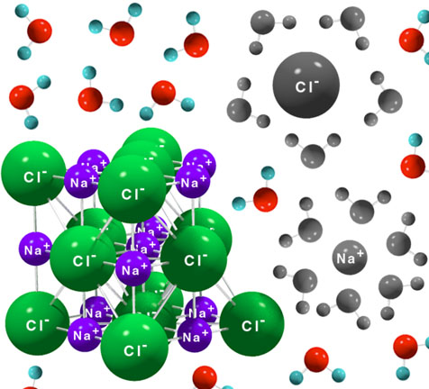
Two ions have become solvated by water molecules and have broken away from the crystal.
The water molecules form a "shell of solvation" around the ions.
The ions that have broken away from the crystal and the water molecules forming the shells of solvation are shown in black and white in this illustration.

Slide 5
The ionic crystal is immersed in a solvent (e.g., water).
Ions become solvated and break away from the crystal.
The crystal is completely broken apart as all of the ions become solvated, and a solution of solvated (aqueous) ions results.

Slide 6
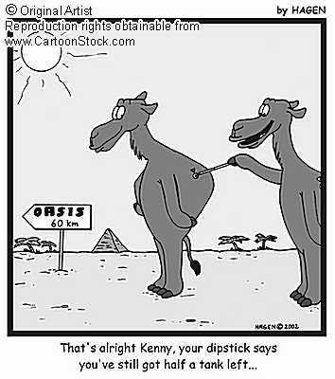
Hydration
Is a solvation process when the solvent is water

Slide 7
Types of Solutions
Solution = SOLVENT + solute
SOLVENT | solute
Solid Liquid Gas | Solid Liquid gas

Slide 8
Concentration Units
Molarity
Mole Fraction
Mass Percent
Molality

Slide 9
Mole Fraction of Solute
MF solute =
Moles of solute
moles of solute + moles of solvent
MF solvent = 1-MF solute

Slide 10
Example
A solution is prepared by mixing 62.6 ml of benzene (C₆H₆ density = 0.879 g/ml mm= 78amu) with 80.3 ml of toluene (C₇H₈ density= 0.867 g/ml mm= 92).
Calculate the mole fraction of these two components.

Slide 11
Determine solute and solvent
Plug and chug
0.867 = mass = 69.6 g = .756 mol (toluene) SOLVENT
80.3
0.879 = mass = 55.0 g = .705 mol (benzene) solute
62.6
MF= 0.705 = 0.48 mol solute
0.705 + 0.756
1 - 0.48 = 0.52 mol solvent

Slide 12
Mass Percent
mass of solute x 100
mass of solution
FYI: solution = SOLVENT + solute

Slide 13
Example
A solution is made containing 6.9 g of NaOH and 100g of water. What is the percent by mass of solute in solution?

Slide 14
Answer
mass of solute x 100
mass of solution
6.9 X 100 = 6.5% solute
100 + 6.9

Slide 15
Molality (m)
The number of moles of solute in one kg of SOLVENT
= moles solute
kg SOLVENT

Slide 16
Example
Determine the molality of a solution that contains 36.5 g of naphthalene C₁₀H₈ \in 420 g of toluene C₇H₈

Slide 17
Answer
Molality = moles solute
kg SOLVENT
36.5 g naphthalene = .285 moles
420 g toluene = .42 kg
= .285/.42 = 0.679 moles/kg

Slide 18
Homework new
Pg 554
#’s 29,31,32,36
Solutions Worksheet

Slide 19
Attractive Forces in Solutions
1. solute – solute interactions
2. SOLVENT – solute interactions
3. SOLVENT – SOLVENT interactions

Slide 20
Enthalpy of Solution
The net enthalpy change is forming a solution is the sum of enthalpy changes that correspond to each of these three interactions.
Enthalpy of solutions tutorial

Slide 21
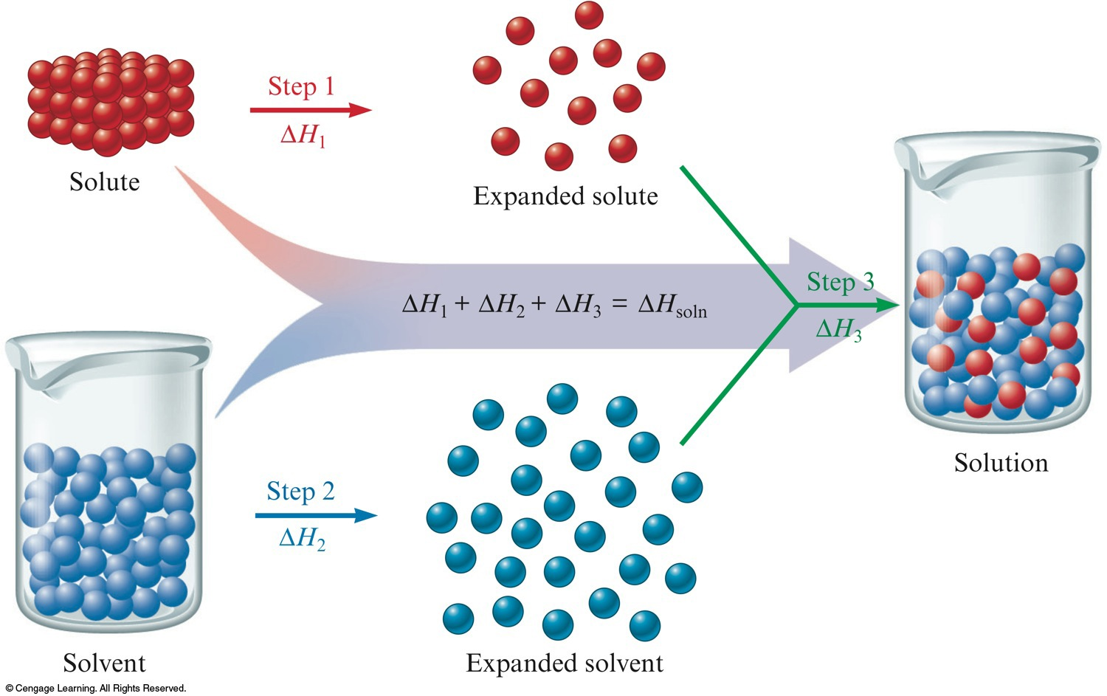
ΔH_{soln} = ΔH1_{solu-solu} + ΔH2_{solv-solv} + ΔH3_{solu-solv}

Slide 22
ΔH_{soln} = ΔH_{solu-solu} + ΔH_{solv-solv} + ΔH_{solu-solv}
ΔH_{solu-solu} = energy to separate solutes from each other (endotheric process)
ΔH_{solv-solv} = energy to separate solvents from each other (endotheric process)
ΔH_{solu-solv} = energy between solute and solvent particles forming (exothermic process)
ΔH_{soln} = can be endothermic or exothermic
FYI: if too endothermic a solution will NOT form

Slide 23
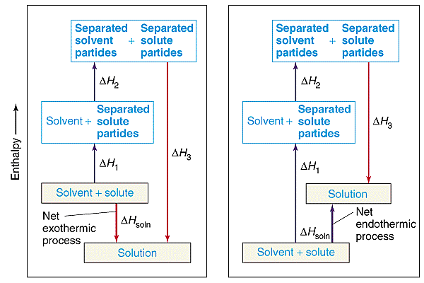

Slide 24
The Energy Terms for Various Types of Solutes and Solvents
 | ΔH₁ | ΔH₂ | ΔH₃ | ΔH_{soln} | Outcome
Polar solute, polar solvent | Large | Large | Large, negative | Small | Solution forms
Nonpolar solute, polar solvent | Small | Large | Small | Large, positive | No solution forms
Nonpolar solute, nonpolar solvent | Small | Small | Small | Small | Solution forms
Polar solute, nonpolar solvent | Large | Small | Small | Large, positive | No solution forms

Slide 25
CONCEPT CHECK!
Explain why water and oil (a long chain hydrocarbon) do not mix. In your explanation, be sure to address how ΔH plays a role.
Oil is a mixture of nonpolar molecules that interact through London dispersion forces, which depend on molecule size. ΔH₁ will be relatively large for the large oil molecules. The term ΔH₃ will be small, since interactions between the nonpolar solute molecules and the polar water molecules will be negligible. However, ΔH₂ will be large and positive because it takes considerable energy to overcome the hydrogen bonding forces among the water molecules to expand the solvent. Thus ΔH_{soln} will be large and positive because of the ΔH₁ and ΔH₂ terms. Since a large amount of energy would have to be expended to form an oil-water solution, this process does not occur to any appreciable extent.
Notes:
Oil is a mixture of nonpolar molecules that interact through London dispersion forces, which depend on molecule size. ΔH₁ will be relatively large for the large oil molecules. The term ΔH₃ will be small, since interactions between the nonpolar solute molecules and the polar water molecules will be negligible. However, ΔH₂ will be large and positive because it takes considerable energy to overcome the hydrogen bonding forces among the water molecules to expand the solvent. Thus ΔH_{soln} will be large and positive because of the ΔH₁ and ΔH₂ terms. Since a large amount of energy would have to be expended to form an oil-water solution, this process does not occur to any appreciable extent.

Slide 26
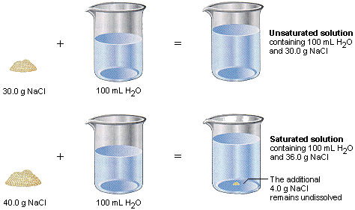
More types of solutions
More types of solutions
Unsaturated solution: solutions containing less solute than a saturated solution
Saturated: solution is in equilibrium with dissolved solute

Slide 27
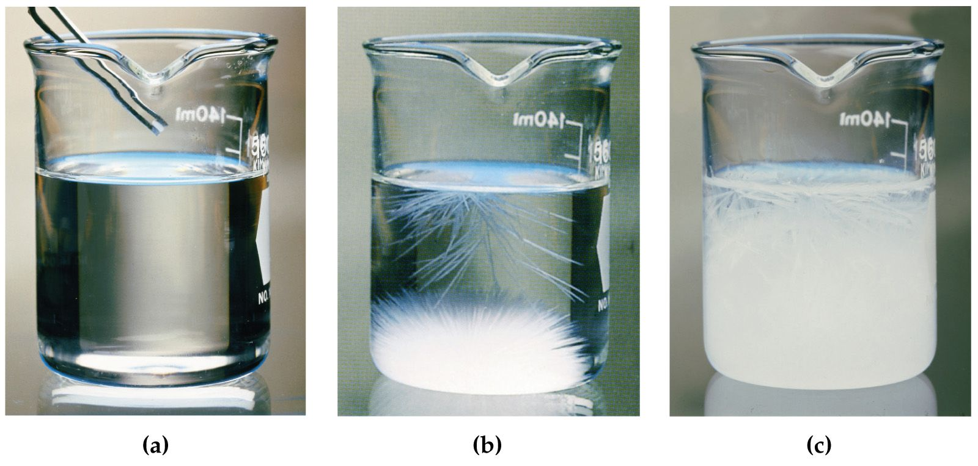
Supersaturated solution: unstable and solute will crystallize to give a saturated solution.

Slide 28
Properties that effect solubility
Properties of components of solution
Like dissolves like if not…precipitate forms
Pressure
The solubility of a gas ↑as pressure over the solvent ↑

Slide 29
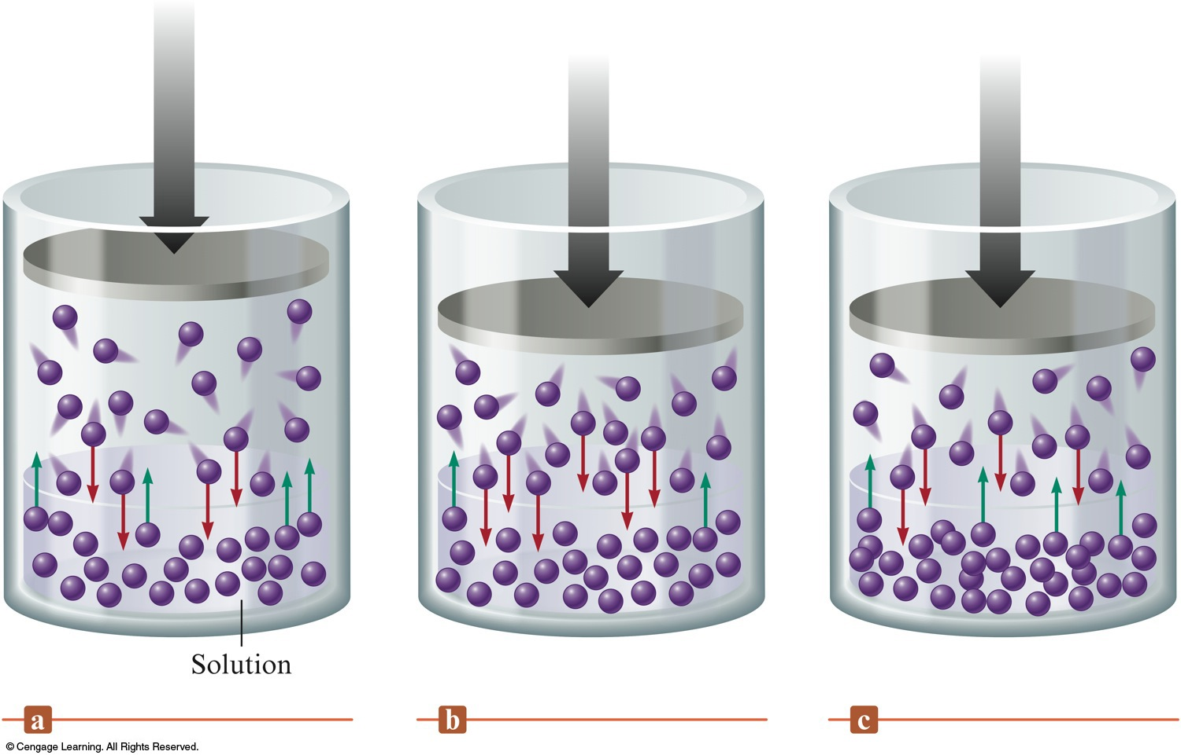
Amount of gas dissolved in a solution is directly proportional to the pressure of the gas above the solution.

Slide 30
Temperature effects pressure
Solubility of a gas ↓ as temperature ↑
Solubility of ionic compounds ↑temperature ↑

Slide 31
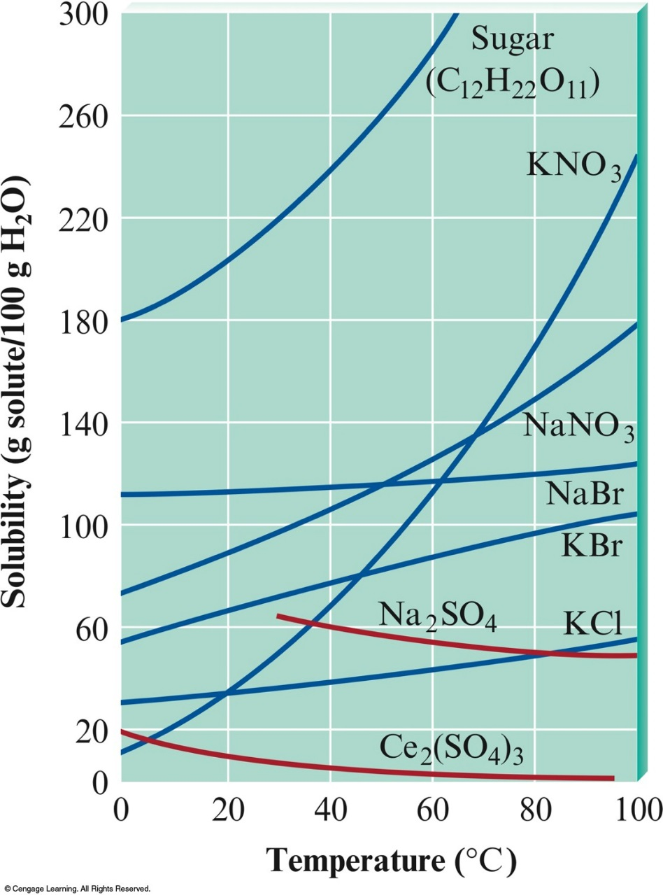
Solubilites of Several Solids as a Function of Temperature
Although the solubility of most solids in water increases with temperature, the solubilities of some substances decrease with increasing temperature.
Can you find an example of this?

Slide 32
Colligative Properties
Properties of the solution that depend on the number of solute particles in the solution.
Vapor pressure lowering (Raoult’s Law)
Freezing point depression
Boiling point elevation
All depend on the concentration of solute particles present in the solution

Slide 33
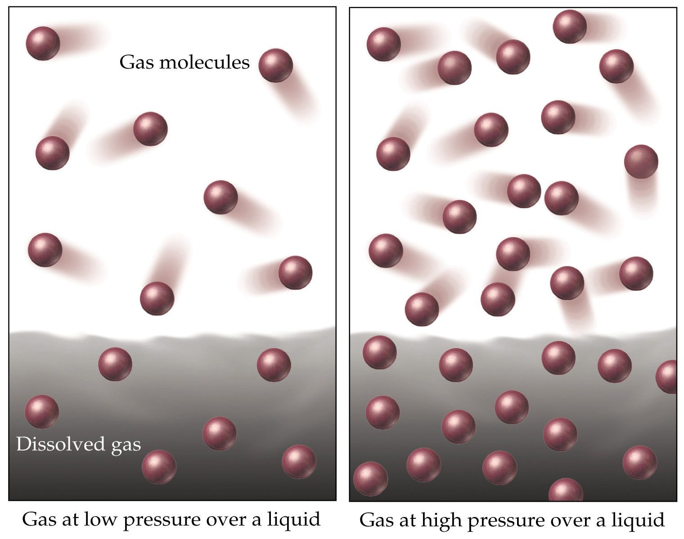
Henry’s Law
The amount of gas dissolved in solution is directly proportional to the pressure of the gas above the solution
P₁ = C₁
C₂ P₂

Slide 34
Vapor pressure lowering
Nonvolatile solutes
(any substance that will not evaporate at ordinary or room temperature.)
lower the VP of volatile solvents (evaporating readily at normal temperatures and pressures)

Slide 35
Raoult’s Law
When a solute is added to a solution the VP of the solution will decrease.
The direct result of a ↓in VP is a ↑in BP
Raoult’s Law:
P_{soln} = observed vapor pressure of solution
_{solv} = mole fraction of solvent
= vapor pressure of pure solvent

Slide 36
Liquid/Vapor Equilibrium
To play movie you must be in Slide Show Mode
PC Users: Please wait for content to load, then click to play
Mac Users: CLICK HERE

Slide 37
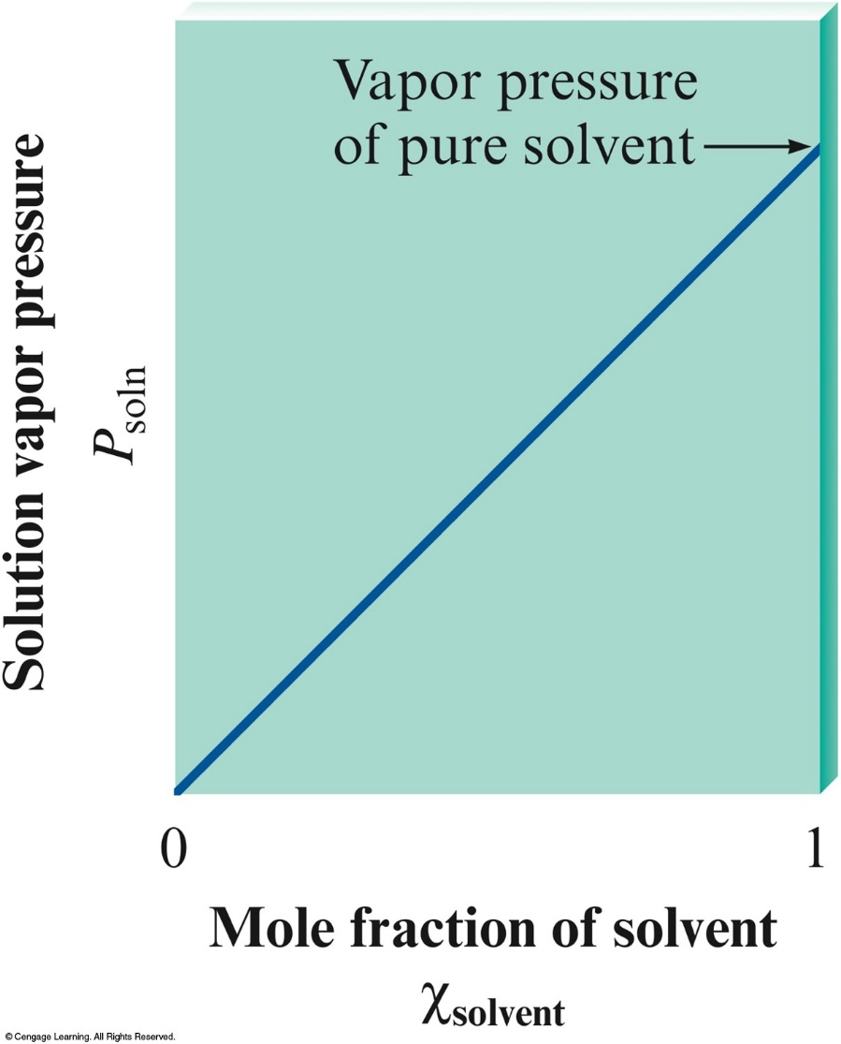
A Solution Obeying Raoult’s Law

Slide 38
Freezing Point Depression
When a solute is added to a solution, the freezing point of the solution decreases
ΔT = ik_{f}m
i = Van’t Hoff factor , the number of particles into which the add solute dissociates
H₃PO₄ = 3H⁺ PO₄ = 4 particles CHO = 1 particle
k_{f} = the freezing point depression constant for the solvent (pg 537 in your text)
m = molality

Slide 39
These types of problems on the AP
Either they will give you the k_{f} or the i and you will need to remember the equation.

Slide 40
Freezing Point Depression: Solid/Liquid Equilibrium
To play movie you must be in Slide Show Mode
PC Users: Please wait for content to load, then click to play
Mac Users: CLICK HERE

Slide 41
Freezing Point Depression: Addition of a Solute
To play movie you must be in Slide Show Mode
PC Users: Please wait for content to load, then click to play
Mac Users: CLICK HERE

Slide 42
Boiling Point Elevation
When solute is added to solution, the boiling point of the solution increases.
ΔT = ik_{b} m
i = Van’t Hoff factor , the number of particles into which the add solute dissociates
K_{b} = the boiling point elevation constant for the solvent (pg 537)
m = molality

Slide 43
Boiling Point Elevation: Liquid/Vapor Equilibrium
To play movie you must be in Slide Show Mode
PC Users: Please wait for content to load, then click to play
Mac Users: CLICK HERE

Slide 44
Boiling Point Elevation: Addition of a Solute
To play movie you must be in Slide Show Mode
PC Users: Please wait for content to load, then click to play
Mac Users: CLICK HERE

Slide 45
Osmotic Pressure
The net movement of solvent through a semi-permeable membrane toward a solution with greater concentration of solute concentrations.
(the solvent will try to dilute the solution)

Slide 46
Osmosis
To play movie you must be in Slide Show Mode
PC Users: Please wait for content to load, then click to play
Mac Users: CLICK HERE

Slide 47
The pressure required to prevent osmosis is known as osmotic pressure
The greater the concentration of the solute in solution the lower the osmotic pressure

Slide 48
Osmotic Pressure
П = MRT
П = osmotic pressure in atm
M= molarity mol/L
R= 0.0821 atm/mol*L*K
T= K

Slide 49
Example:
What is the Osmotic pressure at 20°C of 0.0020 M sucrose solution?
П = MRT
П = 0.0020 (0.0826)(293)
= 0.048 atm

Slide 50
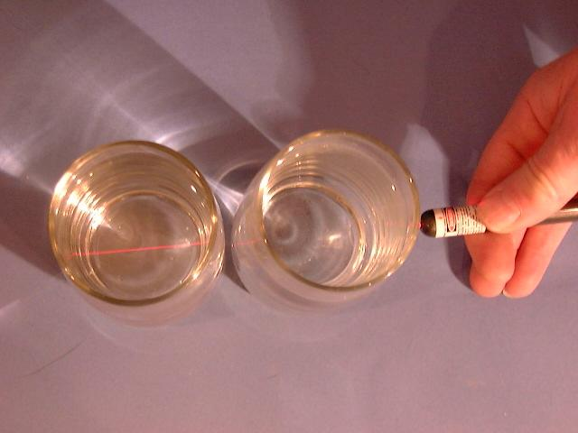
Colloids
A suspension of particles in a medium is a colloid
Tyndall effect is seen here using a laser pointer. The glass on the left contains 5 ppm of HVAC colloidal silver and the one on the right is from the tap after the bubbles have settled out.

Slide 51
Homework
Chapter 11 Homework 2 slides 19-end wks
AP book Multiple choice

