Slide 1
Chapter 14 Acids and Bases
10/75 MC questions
Appears in Free Response section Every Year
Online tutorials

Slide 2
14.1 Nature of Acids and Bases
Acids: Sour Taste
If a solution has a high
[H⁺] = acidic
Base: Bitter Taste / Slippery feel
If a solution has a high
[OH⁻] = base

Slide 3
Arrhenius Concept
Focuses on what ions were formed when acids and bases dissolved in water.
Acids dissociate in water give hydrogen ions (H⁺ or H₃O+)
Bases dissociate in water give hydroxide ions (OH⁻) .
If Solution [H⁺] > [OH⁻] = acidic

Slide 4
Arrhenius acid - Any substance that ionizes when it dissolves in water to give the H+ ion.
e.g.
Arrhenius base - Any substance that ionizes when it dissolves in water to give the OH- ion.
e.g.

Slide 5
The theory can only classify substances when they are dissolved in water since the definitions are based upon the dissociation of compounds in water.
It does not explain why some compounds containing hydrogen such as HCl dissolve in water to give acidic solutions and why others such as CH₄ do not.
The theory can only classify substances as bases if they contain the OH⁻ ion and cannot explain why some compounds that don't contain the OH⁻ such as Na₂CO₃ have base-like characteristics.

Slide 6
Bronsted Lowery Acid Base Concept
Acid: substance that can donate a proton (+)
Base: substance that accepts a proton (+)
Unlike Arrhenius concept this is applicable in both aqueous and non-aqueous states.

Slide 7
Example
NH₃ (aq) + H₂0 (l) → NH₄⁺ (aq) + OH⁻ (aq)
base acid conj. acid conj base
Equilibrium will favor the formation of the weaker acid and the weaker base.
In this rxn the [NH₄] and [OH⁻ ] will be low because they are the stronger acid and base.

Slide 8
In the above reaction, the H⁺ from HCl is donated to H₂O which accepts the H⁺ to form H₃O⁺, leaving a Cl⁻ ion.

Slide 9
Conjugate Acid and Base Pairs
The part of the acid remaining when an acid donates a H⁺ ion is called the conjugate base.
The acid formed when a base accepts a H⁺ ion is called the conjugate acid.

Slide 10
Example
Conjugate acid of HPO₄²⁻ → H₂PO₄¹⁻
^{(+H)}
Conjugate Base of HS¹⁻ → S²⁻
^{(-H)}

Slide 11
For the generic acid HA:
Formed when a proton Is transferred to the base
Everything that is left after a proton is added to the base.
NOTE
Strong acids have weak conjugate bases.
Strong bases have weak conjugate acids.

Slide 12
Figure 14.4 - Strong and Weak Acids

Slide 13
Question
If H₂0 is an acid what would its conjugate base be?
For the reaction
HF + H₂O → H₃O⁺ + F⁻
What is the acid, base , CA, CB?

Slide 14
Answer
H₂0 take away a proton OH⁻
HF + H₂O → H₃O⁺ + F⁻
Acid base CA CB
(gained H+) ( what is left of acid after donation to base)

Slide 15
Amphoteric
The ability of a substance to act as an acid or a base.
Ex: H₂PO₄⁻ and H₂O can act as both acids and bases.

Slide 16
Examples of Amphoteric substances
Donate P⁺ Accept P⁺
H₂PO₄⁻ PO₄³⁻ H₃PO₄
HSO₄⁻ SO4²⁻ H₂SO₄
H₂O OH⁻ H₃O⁺

Slide 17
Back to Old Faithful
In this equation the stronger base will win the competition for H+.
If H2O is a stronger base than A-, then it will have a greater affinity for the protons and the equilibrium will lie to the right favoring the formation of H₃O+.
If A- is stronger then equilibrium will fall to the left and acid in the form HA will form.

Slide 18
Acid-dissociation equilibrium constant (Ka)
The relative strength of an acid is described as an acid-dissociation equilibrium constant.

Slide 19
Think Products over reactants remember water is a solvent here and not in equilibrium

Slide 20
Question
Write reaction for the ionization of the following and then write the acid dissociation constant for both. (all occur in water)
Hydrochloric acid
Acetic acid

Slide 21
Answer
HCl ↔ H⁺ + Cl⁻
K_{a} = [H+] [Cl⁻] / [HCl]
HC₂H₃O₂ ↔ H⁺ + C₂H₃O₂
K_{a} = [H+] [C₂H₃O₂] / [HC₂H₃O₂ ]

Slide 22
14.1 homework
17, 23, 29, 30, 31, 35

Slide 23
Various Ways to Describe Acid Strength

Slide 24
Values of K_{a} for Some Common Monoprotic Acids

Slide 25
Strong Acids Table 14.2
Strong acids dissociate almost completely in water and therefore have relatively large Ka values.
Equilibrium lies far to the right
HA dissociates almost completely
Yield weak conjugate bases
Strong electrolytes (100% conductivity)
K_{a} Large > 1

Slide 26
Weak Acids
Weak acids dissociate only slightly in water and therefore have relatively small Ka values.
Equilibrium lies far to the left (HA does not dissociate)
Yields strong conjugate base
K_{a} small < 1

Slide 27
Strong Acids Conj. Bases
HCl
HBr
HI
HNO₃
HClO₄
HClO₃
H₂SO₄
Cl⁻
Br⁻
I⁻
NO₃⁻
ClO₄⁻
ClO₃⁻
HSO₄⁻
You must memorize all of these

Slide 28
Common Strong Bases
Formula
NaOH sodium hydroxide
LiOH lithium hydroxide
KOH potassium hydroxide
Ba(OH)₂ Barium hydroxide
Sr(OH)₂ Strontium hydroxide

Slide 29
Types of Acids
Oxyacids: have oxygen, the greater the number of O on the central atom the stronger the acid.
HNO_{3,} HClO₄, HClO_{3,} H₂SO₄
Polyprotic: acids that give up more than one hydrogen ion in solution, granted it is easier to give up the 1st proton than the 2nd.
H₂SO₄ , H₃PO₄
Monoprotic: acids with only one proton
HCl , HBr , HI

Slide 30
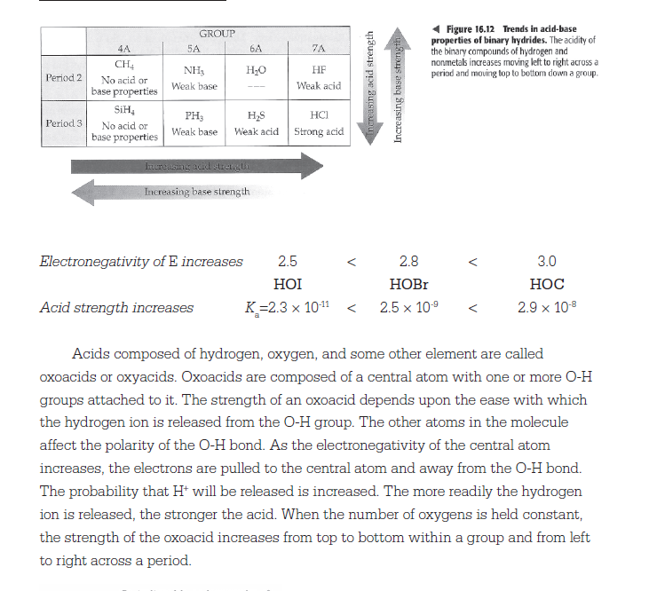

Slide 31
Sample AP Question

Slide 33
Temperature increases as K_{w} increases

Slide 34
Water Quick Facts
H₂O (l) ↔ H⁺ _{(aq)} + OH⁻ (aq)
K_{w} = 1 x 10⁻¹⁴ = [H⁺ ] [OH⁻]
pH + pOH = 14
K_{w} = 1 x 10⁻¹⁴ = K_{a}K_{b}
p K_{a} + pK_{b} = 14

Slide 35
A Note on Significant Figures
Number of decimal places in the log is equal to the number of significant figures in the original number
[H⁺] = 1.0×10^{–9} M
pH = 9.00
2 significant figures
2 decimal places

Slide 36
Concentrations
[H⁺] = [OH⁻] = Neutral
[H⁺] > [OH⁻] = Acid
[H⁺] < [OH⁻] = Base

Slide 37
Example
Calculate the concentrations using
K_{w}= [H⁺] [OH⁻] =10⁻¹⁴
For the following and state if it is an acid, base, or neutral
[OH⁻] = 10⁻⁵ M
[H⁺] = 10.0 M

Slide 38
Answer
K_{w} = 10⁻¹⁴= [H⁺] [10⁻⁵] = 1.0 E⁻⁹ M
[H⁺] < [OH⁻] = Base
K_{w} = 10⁻¹⁴=[10] [OH⁻] = 1.0⁻¹⁵ M
[H⁺] >[OH⁻] = Acid

Slide 39
Formulas to Memorize
pH = -log [H⁺]
pOH = -log [OH⁻]
pK = -logK
pK_{w} = - logK_{w}
pH + pOH =14
Note:
pH + pOH = -logK_{w} =pK_{w} = 14
Acid and base equilibrium constants are expressed as functions of pX thus
Acid = pK_{a}
Base = pK_{b}

Slide 40
14.2 and 14.3 homework
41,44,46

Slide 41
Solving Strong Acid Equations
1. Autoionization of water ALWAYS occurs in aqueous solutions.
2. Determine if autoionization contributes significantly to the acid base character of a solution. (hint look at the Ka values)
3. Since HA dissociates 100% we can ignore the autoinoization of water.

Slide 42
Calculating the pH of weak acids.
List the major species in the solution
Choose the species that can produce the most H⁺, and write a balanced equation for the reactions producing the most H⁺
Write the equilibrium expression for the dominant equilibrium
ICE box ([initial], [change], [equilibrium]

Slide 43
Solving Strong Acid Equations
Since Acids dissociate 100% , the final [H⁺] ions will be the same as the initial [strong acid].
0.010M HCl has a pH of ….
pH = -log [H⁺] = 14
pH = -log [0.010]
pH =2

Slide 44
Weak Acids
HB → H⁺ + B⁻
Only a small percentage of weak acids dissociate into H⁺ and B⁻ (conj base ions)
K_{a} =[ H⁺ ] [B⁻] / [HB]

Slide 45
Weak Acid Calculations
If you know Ka and [acid] you can find pH
Example: 0.20 M HC₂H₃O₂ Ka = 1.8x 10⁻⁵
1.8x 10⁻⁵ = [H+] [C₂H₃O₂ ⁻]
HC₂H₃O₂
Every acid molecule that dissociates produces one H+ and oneC₂H₃O₂ – we can let each of those values = x and write Ka as:
1.8x 10⁻⁵ = X²
0.20-X We can ignore this x since it is so small since stronger acid
Now solve for x and get 1.9 x 10⁻³ = [H+]
and then us pH = -log[H] to find pH

Slide 46
Weak acid example
Calculate the pH of a 0.1 M aqueous solution of HOCl (Ka= 3.4x10⁻⁸ weak acid).
HOCl ↔ H⁺ + OCl⁻

Slide 47
Ka = 3.4x10⁻⁸ = [H⁺][OCl⁻]/HOCL
HOCL H⁺ + OCl⁻
I 0.1 0 0
C -X X X
E 0.1-X X X
Substitute E values into Ka equation
3.4x10⁻⁸ = (x) (x)
0.1-x
X = the amount of HOCl that dissociates
We can ignore this x since it is so small since stronger acid

Slide 48
3.4x10⁻⁸ = x²
0.1
X = 5.9 x 10⁻⁵
[H⁺] = -log 5.9 x 10⁻⁵
pH = 4.23

Slide 49
pH of a mixture of weak acids
Always look to your Ka values to identify the stronger acid and use that data to do your ICE box calculations.
Ka values are in your text on page A24
I will give you Ka’s or a way to calculate them on a test or quiz.

Slide 50
Percent Dissociation (aka % ionization)
% dissociation = [ H⁺]_{final} X 100%
[ H⁺]_{initial}
This equation allows us to identify for the exact concentration of [ H⁺] that must dissociate for the equation to reach equilibrium.

Slide 51
Percent Dissociation
Definition
For a solution of any weak acid HA:
[H⁺] decreases as [HA]₀ decreases
Percent dissociation increases as [HA]₀ decreases

Slide 52
Example
Calculate the % dissociation for 1.0 M HC₂H₃O₂
Ka = 1.8 X 10⁻⁵
HC₂H₃O₂ H⁺ + C₂H₃O₂
I 1.0 0 0
C -X X X
E 1.0-X X X

Slide 53
Ka = 1.8 X 10⁻⁵ = X²/ 1.0
[X] = 4.2 x 10⁻³
% diss = [H+ ]/ HC₂H₃O₂ * 100
= 4.2 x 10⁻³/ 1.0
= 0.42%

Slide 54
Homework 57, 63, 66, 67,

Slide 55
14.6 Bases
When strong bases are dissolved in aqueous solutions they dissociate 100% in OH⁻, so we can treat strong base equations like we treat strong acid equations.

Slide 56
All hydroxides of group 1A and 2A are strong bases.
Exception Be(OH)₂
Strong bases will have large K_{b} values.
Alkaline earth hydroxides are not very soluble and will not dissociate easy in solution.

Slide 57
Weak Bases
B _{(aq)} + H₂O BH⁺ _{(aq)} + OH⁻_{(aq)}
Base Acid Conj. Acid Conj Base
React with water to form conjugate acid of the base and OH⁻ ion.
Small K_{b} values
See Table 14.3 for a list of weak bases to know.

Slide 58
Example
Calculate the pH of 0.05 M solution of pyridine, K_{b} = 1.7 x 10⁻⁹
**** K_{b} is small and tells us pyridine a weak base

Slide 59
Answer
B _{(aq)} + H₂O BH⁺ _{(aq)} + OH⁻_{(aq)}
Base Acid Conj. Acid Conj Base
( H₂O is and acid so we can ignore it since we are given k_{b})
I 0.05 0 0
C -x x x
E 0.05-x x x

Slide 60
1.7 x 10⁻⁹ = x²
0.05
[x] = [OH⁻] = 9.2 x 10⁻⁶
pOH = - log (9.2 x 10⁻⁶) = 5.04
pH + pOH = 14
pH + 5.04 = 14
pH = 8.96

Slide 61
Other Questions
Which of the following compounds produce the highest pOH as a 0.05M solution. (look for the highest K_{b})
Ammonia (K_{b} = 1.8 x 10⁻⁵)
Methylene (K_{b} = 4.4 x 10⁻⁴)
Dimethylamine (K_{b} = 5.4 x 10⁻⁴)
Pyridine (K_{b} = 1.7 x 10⁻⁹)

Slide 62
Another Formula(s)
K_{a} x K_{b} = K_{w}
p_{ka} + p_{kb} = 14
p_{ka} = -log K_{a}
p_{kb} = -log K_{b}

Slide 63
pH Calculation Flow Chart
K_{w} = 1.0 x 10-14 = [H+] [OH-]
[OH-]
pOH = - log [OH-]
10 - pOH = [OH-]
pOH
[H+]
pH = - log [H+]
10 - pH = [H+]
pH
pH + pOH = 14

Slide 64
Example
Calculate the K_{a} for NH₄⁺ if K_{b} for
NH₄⁺ = 1.8 x 10⁻⁵
K_{a} NH₄⁺ = K_{w} / K_{b}
K_{a} = 1.0 x 10⁻¹⁴ / 1.8 x 10⁻⁵

Slide 65
Lewis Acid’s
Lewis Acid: a substance that accepts an electron pair
Lewis Base: a substance that donates and electron pair.

Slide 66
Keeping it straight
Model | Definition of Acid | Definition of Base
Arrehnius | H⁺ producer In water | OH⁻ Producer In water
Bronsted- Lowery | H⁺ donor | H⁺ acceptor
Lewis | Electron pair acceptor | Electron pair donor

Slide 67
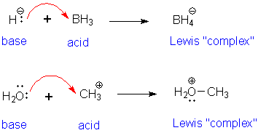
Note
Note: All Bronsted-Lowery base is a Lewis base
Not every Lewis base is a Bronsted-Lowery base, because a Lewis base can give a pair of electrons to H⁺ or any other molecule that can accept them.

Slide 68
Another example to convince you
Brønsted-Lowry acid-base reaction = donation and acceptance of a proton
Lewis base (OH¹⁻) = hydroxide ion donates a pair of electrons for covalent bond formation, Lewis acid (H⁺ ) = accepts the pair of electrons.

Slide 69
Lewis Example
For each rxn identify the Lewis acid and base.
Ni₂⁺ + 6NH₃ → Ni(NH₃)₆²⁺
H⁺ + H₂O ↔ H₃O⁺

Slide 70
Answer
A: each NH₃ (Lewis acid) accepts an electron pair to Ni₂⁺ (Lewis Base)
B: The proton (H⁺) is the Lewis acid and the water is the Lewis base.

Slide 71
Homework
75, 81 a, 123, 124, 125, 128

Slide 72
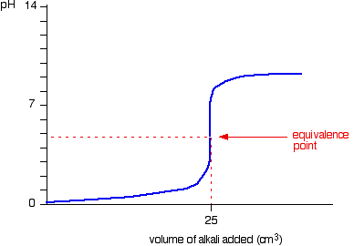
Titration curves
Titration curves are useful because they are good graphic representations of exactly what occurs during a titration process
Strong
Weak

Slide 73
Acid Base Indicators
Strong acid, the equivalence point occurs at pH 7.0.
Bromothymol blue is the best of the three indicators for this titration. But the color changes for methyl orange , bromothymol blue, and phenolphthalein will all occur at nearly the same volume of added base.
Weak acid, the methyl orange color change will occur long before the equivalence point, the bromothymol blue change is slightly premature, and phenolphthalein color change occurs close to the correct place (around pH 8.9). The weaker the acid is, the larger the discrepancy between the three indicator endpoints will be.

Slide 74
Equivalence point
the point at which the equivalents of acid equals the equivalents of base
The steepest slope on the graph

Slide 75
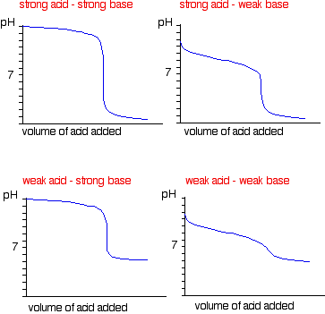

Slide 76
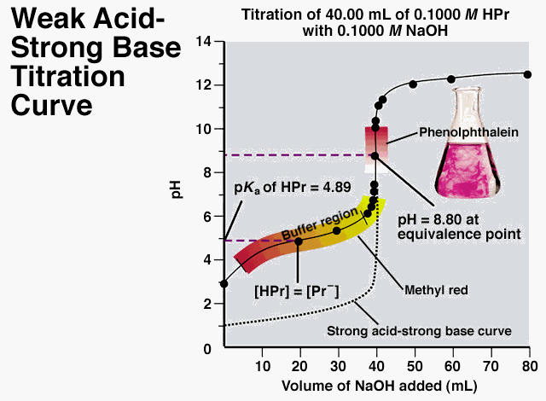
What a Titration curve of a weak acid tell us!
Initial pH tell the strength of the acid and its [ X ]
pH at eq.pt reveals that the CB of a WA is a WB. Due to the volume of bases needed to reach this pt.
pH pH of the half neutralizaion point is = to pKa of th WA
The shape of the curve is the half neutralization shows the buffering capacity of a WA and its CB

Slide 77
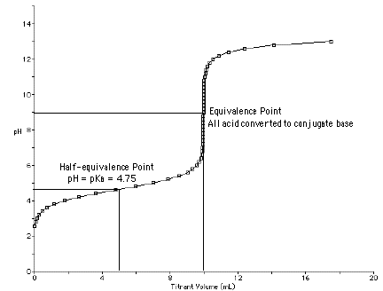
Half Equivalence point
half the amount of base added which is needed for a complete reaction

Slide 78
pKa
pKa helps us better describe the strength of weak acids. Since Ka reflects both the unionized [HA] and ionized species [A] in a reaction, we can use pKa to talk only about the H⁺ in the solution.

Slide 79
pKa
↓ pKa ↑ the acid strength
↓ pKa the more stable the conj. Base is!

Slide 80
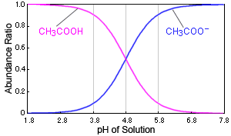
How to find pKA
pKa = - log Ka
pKa and pH are equal when exactly half of the acid has dissociated.
pH = pKa = 4.8

Slide 81
Henderson Hasselbach equation
Helps us measure the pH of a buffer solution as well as the pH at which an indicator will change color.
(question 2 in Flinn Lab 15)
Think [base (aka conj acid) ]
[Acid]

Slide 82
https://www.youtube.com/watch?v=q7Uk20Adf-4

