Slide 1
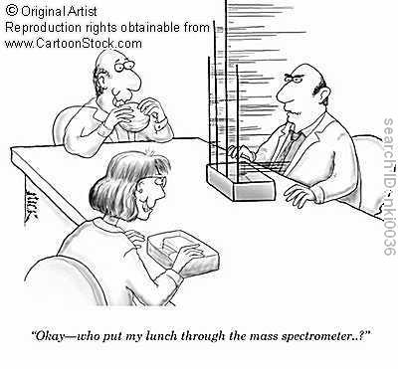
Chapter 7
Atomic structure and Periodicity

Slide 2
7.1 Electromagnetic Radiation
Radiant energy that acts like a wave and travels through space at the speed of light.
Earth’s Radiant Energy

Slide 3
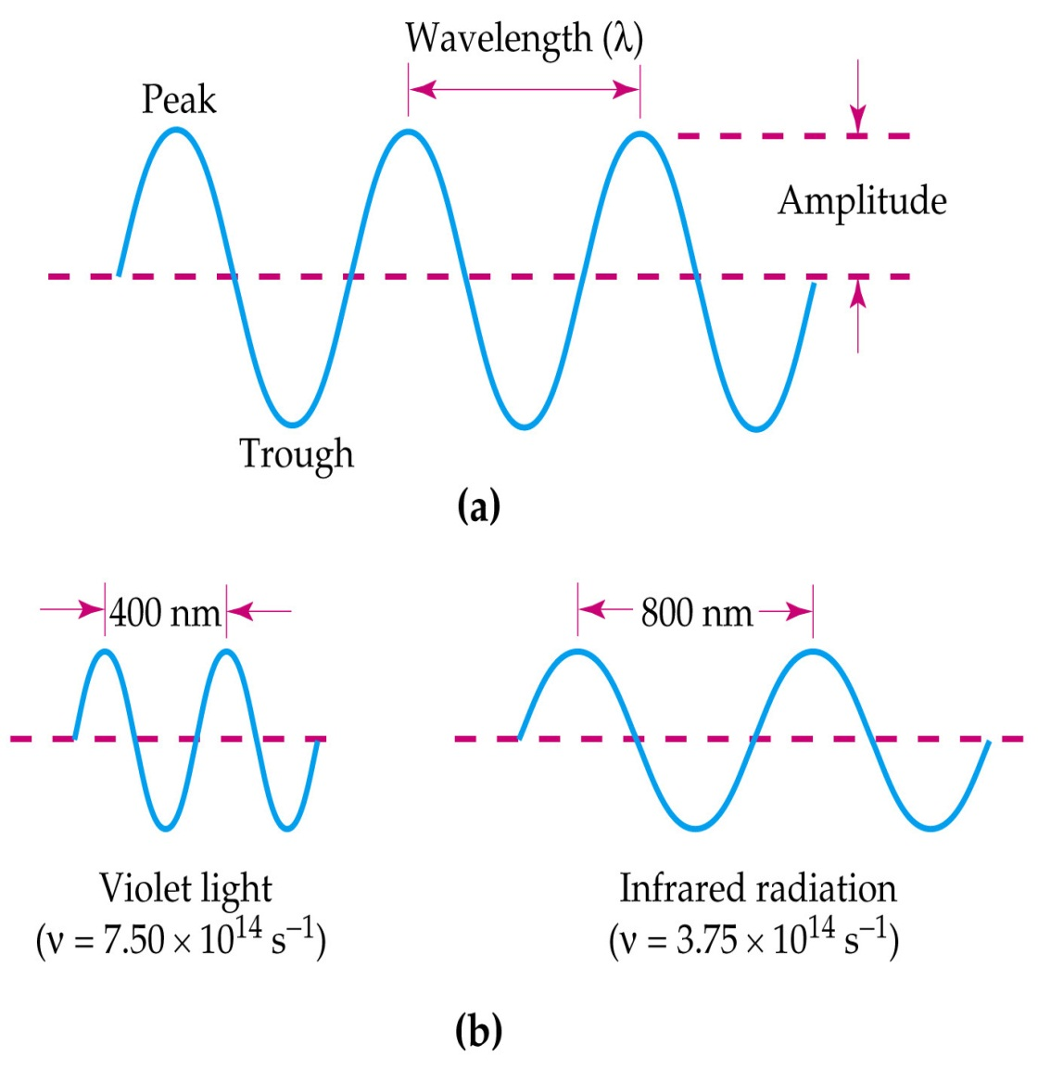
Wave characteristics
Wavelength: λ, lambda
Distance between peaks or troughs in a wave
Frequency: ν, nu
number of waves, per second that pass a point in one second.
Speed: you know this one.

Slide 4
Which color has the highest frequency?
Lowest frequency?
Largest wave length?
Smallest wavelength?

Slide 5
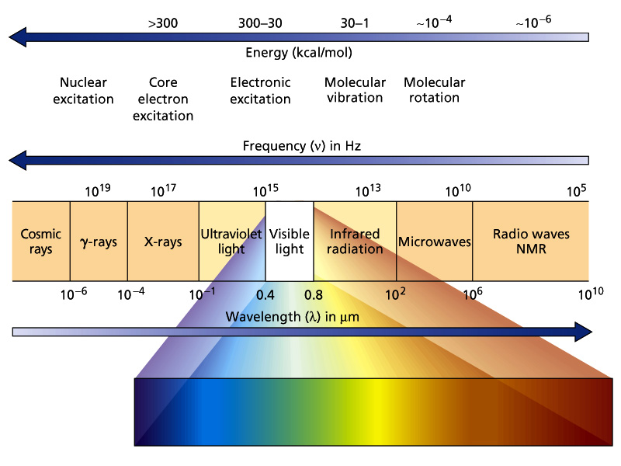
Electromagnetic Spectrum

Slide 6
Relationship between λ and ν
Wavelength and frequency are inverses of each other.
λv = c
λ = wavelength in meters (m)
ν = frequency in cycles per second (1/s or s⁻¹ or Hertz)
c = speed of light 3.0 x 10⁸ m/s

Slide 7
Try one!
The red wavelength emitted form red fireworks is around 650 nm and results when strontium salts are heated. Calculate the frequency of red light with a wavelength of 6.50 x 10² nm.
λν = c
6.50 x 10² nm = 6.50 x 10⁻⁷ m
v = 4.61 x10¹⁴ s⁻¹ or Hz

Slide 8
Atoms and Light
The movement of electrons inside of atoms produces light and other electromagnetic radiation.
Sunlight produces every color in the rainbow but…
Each element gives off only certain frequencies of light, called spectral lines. In effect each element has its own signature of spectral lines allowing us to identify which element we have or what stars are made of.

Slide 9
The Line Spectrum of Hydrogen
To play movie you must be in Slide Show Mode
PC Users: Please wait for content to load, then click to play
Mac Users: CLICK HERE

Slide 10
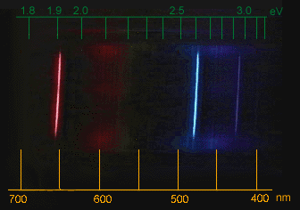
Below is a picture of the spectral lines given off by hydrogen. Note there are 3 different frequencies.

Slide 11
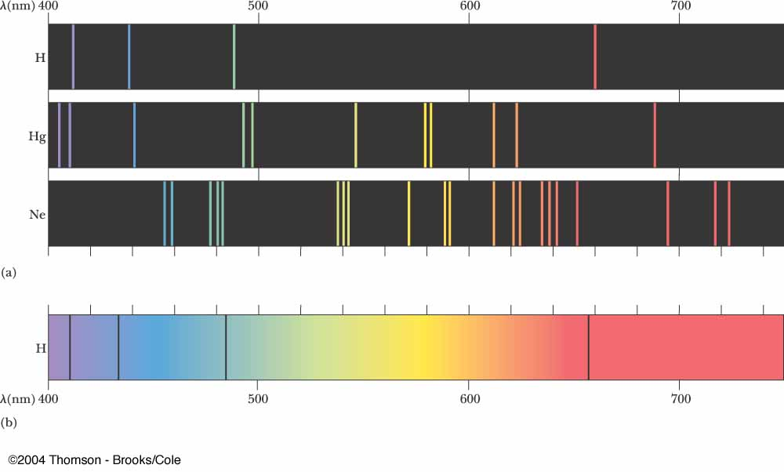
Emission Spectra

Slide 12
Spectrophotometer
Measures absorbance or transmittance of light as a function of wavelength
Sample is placed into cuvette
Light of selected wavelength is passed through sample
Amount of light absorbed is measured

Slide 13
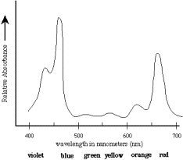
How to choose wavelength
We want to analyze samples using the wavelength at which the most light is absorbed – Wavelength of maximum absorption (λmax)

Slide 14
Beer’s Law
Amount of light absorbed is proportional to the concentration of the solution
A = abc
A = absorbance
a = proportionality constant
(ε = molar absorptivity)
b = path length (same for entire experiment)
c = concentration (M)

Slide 15
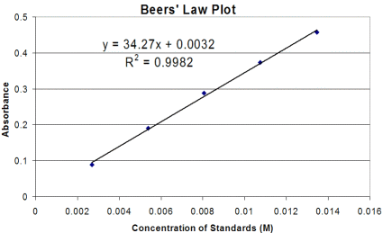
What does this tell us?
There is a direct relationship between absorbance (A) and concentration (c).
When we prepare solutions of known concentration and analyze them at λmax, we can plot absorbance as a function of concentration.

Slide 16
The concentration of the unknown can be determined by finding its absorbance and plugging it into the equation for the best fit line.
y = mx + b

Slide 17
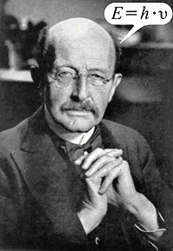
7.2 Planck’s Constant
Max Planck discovered that energy could be gained or lost in multiples of hv.
Thus energy is quantized or in steps or packages. Energy can only be transferred as a whole package or quanta.
h = 6.626 x 10⁻³⁴ J *s
or kg * m²/s

Slide 18
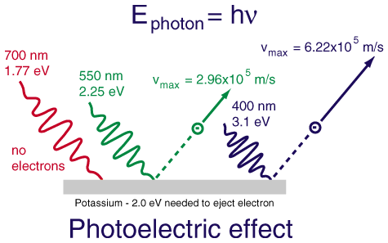
The photoelectric effect – When light shines on metals, electrons (photoelectrons) are ejected from their surface.
A certain frequency has to be achieved or the effect does not work
Red light will not cause electrons to eject!

Slide 19
PES

Slide 20
Solving equations with Planck’s
ΔE = change in energy, in J
h = Planck’s constant, 6.626 × 10⁻³⁴ J s
ν = frequency, in s⁻¹
λ = wavelength, in m

Slide 21
Calculating energy lost
The blue color in fire works is the result of heated CuCl at 1200 °C. Then the compound emits blue light with a wavelength of 450 nm. What is the increment of energy (quantum) that is emitted at 4.50 x 10² nm by CuCl?

Slide 22
Answer
ΔE = hν v = c/λ
v = 3.0 x 10⁸ m/s = 6.66 x 10¹⁴ s⁻¹
4.50 x 10-7 m
(6.626 x 10⁻³⁴ J *s) x (6.66 x 10¹⁴ s⁻¹)
= 4.41 x10⁻¹⁹J (quantum energy lost in this increment)

Slide 23
photons
Einstein proposed that electromagnetic radiation was quantized into particles called photons.
The energy of each photon is given by the expression:
E_{photon} = hν = hc/λ

Slide 24
Dual Nature of Light
Light can behave as if it consists of both waves and particles.
Thus light energy has
mass

Slide 25
Old-ie but good-ie
Energy has mass
E = mc²
E = energy
m = mass
c = speed of light

Slide 26
The relationship between energy and mass ….

Slide 27
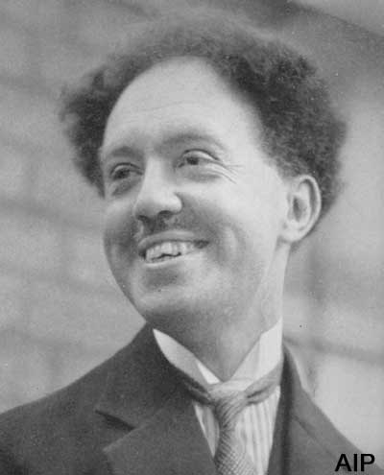
De Broglie
We can calculate the wavelength of a particle
λ = wavelength, in m
h = Planck’s constant, 6.626 × 10⁻³⁴ J s
v = velocity (symbols pg 296-297)
m = kg

Slide 28
Question
Compare the wavelength for an electron (mass = 9.11 x10 ⁻³¹ kg) traveling at a speed of 1.0 x10⁷ m/s with that of a ball (mass = 0.10 kg) traveling at 35 m/s

Slide 29
Answer
Electron wavelength = 7.27 x 10 ⁻¹¹ m
ball wavelength = 1.9 x 10 ⁻³⁴ m

Slide 30
Light Vocabulary
Diffraction: results when light is scattered from a regular array of points or lines

Slide 31
Homework
Pg 341
39,41,43,45*,47

Slide 32
7.5 Quantum model of an atom
Compared the relationship between the electron and the nucleolus of an atom to that of a standing or stationary wave.

Slide 33
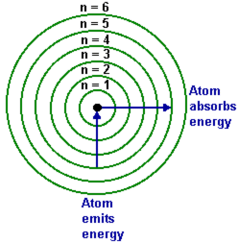
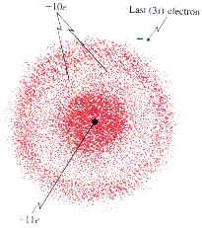
Probability
Bohr Model
Probability distribution
Electron Cloud
Radial probability distribution

Slide 34
Heisenberg Uncertainty Principle
Blew the Bohr model out of the water. It states that we an only know so much about the exact position and momentum of an electron.

Slide 35
7.6 Quantum numbers!!!!!
Quantum numbers describe various properties of the electrons in an atom.
There are 4 quantum numbers
Principal quantum number (n)
Angular momentum quantum number (ℓ)
Magnetic quantum number (m_{ℓ})
Electron spin quantum number (m_{s})

Slide 36
Principal quantum number (n)
Integral values 1,2,3,4….
Related to the size and energy of the orbital
Referred to as the shell or energy level

Slide 37
Principal quantum number (n)
As n increases energy increases because the electrons are farther away from the nucleus and less tightly bound to the positively protons.
n=1
n=4

Slide 38
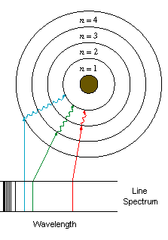
The Bohr Model
Bohr interpreted the lines in the spectra of gases as formed by the transitions of electrons to and from various energy-levels.
The lines on the visible light spectrum correspond to the transition from high levels of n to low level of n

Slide 39
Angular momentum quantum number (ℓ)
Integral numbers with values from 0 to n-1
if n = 3 possible ℓ values are 0,1,2
Sometimes referred to as the “sub shell” number
ℓ | Orbital shape
0 | s
1 | p
2 | d
3 | f
4 | g

Slide 40
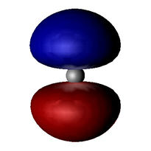
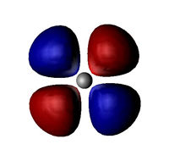
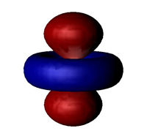
Shape of orbitals
ℓ | Orbital shape
0 | s
1 | p
2 | d
3 | f
4 | g

Slide 41
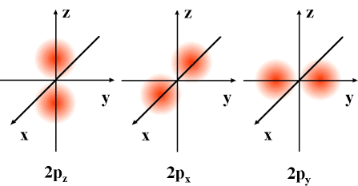
Magnetic quantum number (m_{ℓ})
Integral values from ℓ to -ℓ including zero
If ℓ = 2 m_{ℓ} = 2, 1, 0, -1, -2
Relates to the orientation of the orbital in the atom. .

Slide 42
Electron spin quantum number (m_{s})
can only have one of two values
+1/2 or -1/2
each orbital can
Hold 2 electrons
+ ½ - ½

Slide 43
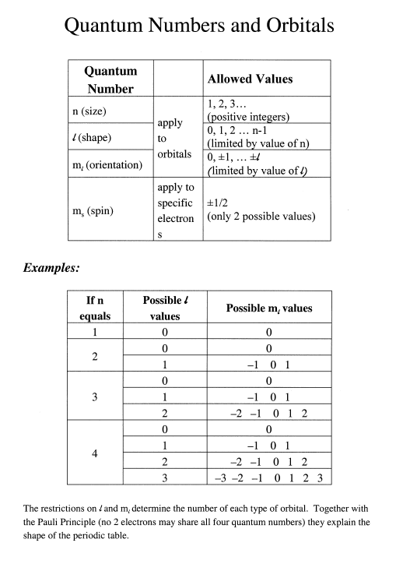

Slide 44
Principle Quantum # = n | # of possible l values |  |  | Sublevel Shape (ℓ) | Orbital number (ℓ) | Electron Capacity (one per orbital)
1 | 1 | s |  | S | 1 | 1 x 2 = 2e
2 | 2 | s p |  | p | 3 | 3 x 2 = 6e
3 | 3 | s p d |  | d | 5 | 5 x 2 = 10e
4 | 4 | s p d f |  | f | 7 | 7 x 2 = 14e
5 | 5 | s p d f g |  | g | 9 | 9 x 2 = 18e
6 | 6 | s p d f g h |  | h | 11 | 11 x 2 = 22e
7 | 7 | s p d f g h i |  | i | 13 | 13 x 2 = 26e
Note: In order for the d orbital to be filled the s and p orbitals must be filled.

Slide 45
question
For the principle quantum level n = 5
Determine the number of allowed sub shells (ℓ) and give the number and letter designation of each

Slide 46
Answer
Recall: Angular momentum quantum
Integral numbers with values from 0 to n-1
n = 5 ℓ = 0 to n-1
ℓ = 4g,3f,2d,1p,0s

Slide 47
Nomenclature
n value ℓ value number of electrons in orbital
2p^{Y}_{x}
orientation in space (rarely see this)

Slide 48
Sorting our the numbers
Orbitals with the same n value are in the same shell.
Ex: n = 3 is the third shell
One or more orbitals with the same set of n and ℓ values are in the same sub shell
Ex: n = 3 ℓ= 2 3d sub shell
n = 3 ℓ = 1 3p sub shell

Slide 49
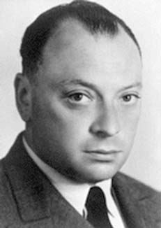
Pauli exclusion principle
In a given atom no electrons can have the same 4 quantum number
So when we put more than one electron in an orbital we must alternate the spin. Thus m_{s}

Slide 50
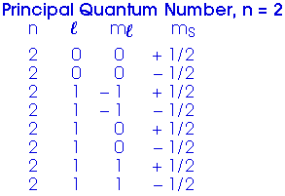

Slide 51
Example of Pauli Exclusion Principal
Quantum numbers for 2s²
n l m_{l} m_{s}
2s 2 0 0 +1/2
2s 2 0 0 -1/2
When ever possible electrons will prefer to have a positive spin. In this case this orbital will only hold 2 e- so one must be negative

Slide 52
Question ?
What would the 4 quantum numbers be for 3p³?
Note: all electrons have positive spin We will get to why in a minute

Slide 53
Answer
n l m_{l} m_{s}
3p 3 1 0 +1/2*
3p 3 1 1 +1/2*
3p 3 1 -1 +1/2*

Slide 54
Homework
Pg 342 60, 61, 62, 64, 70

Slide 55
Electron configuration
The order in which electrons are distributed to orbitals
We need to have rules for how we distribute electrons. Other wise all the electrons would be in the 1s orbital because it has the lowest energy
(e- ♥ ground state)

Slide 56
Rule 1: Aufbau Principle “building up”
Shells fill based on their energy level.
Lower energy shells fill first followed by high energy shells.
START

Slide 57
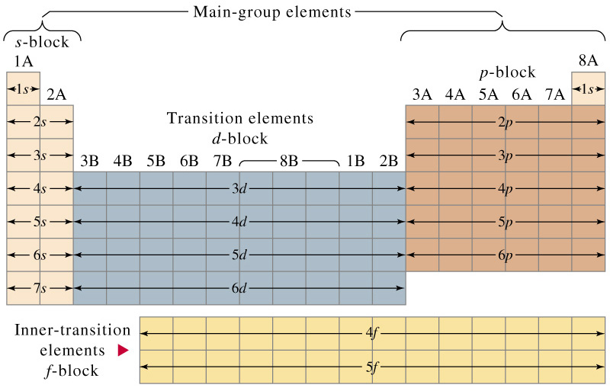
H: 1s¹
He: 1s²
Li: 1s² 2s¹

Slide 58
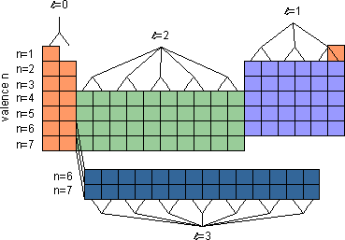
p
s
d
f

Slide 59
How to write EC?
Li
1s 2s
3 electrons
1s² 2s¹
Orbital Diagram electron configuration

Slide 60
Question ?
What is the electron configuration for Carbon?

Slide 61
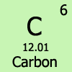
Answer
C
Carbon has 6 electrons
1s² 2s² 2p²

Slide 62
Hund’s Rule: “the grocery line rule”
Electrons are distributed among the orbitals or a sub shell in a way that gives the maximum number of unpaired electrons.
C
1s² 2s² 2p²

Slide 63
Question
Write the orbital diagrams and electron configurations for the electron configurations of each element.
Nitrogen
Oxygen
Fluorine
Potassium

Slide 64
Answer

Slide 65
A note on vocabulary
Diamagnetic: all electrons are spin paired
Paramagnetic: not all electrons are spin paired

Slide 66
Question
Of the following elements which are diamagnetic and which are paramagnetic?
Boron
Oxygen
Neon

Slide 67
Valence Electrons
The electrons in the outermost principle quantum level of an atom. Ve- = to group #
Atom Ve- Location
Ca 2 4s
N 5 2s 2p
Br 7 4p
Inner electrons are called core electrons.

Slide 68
Short and Sweet!
Writing the EC for Carbon is one thing but Xenon (54e-), Argon (18e-)?
To write the condensed EC look to the noble gas BEFORE your element.

Slide 69
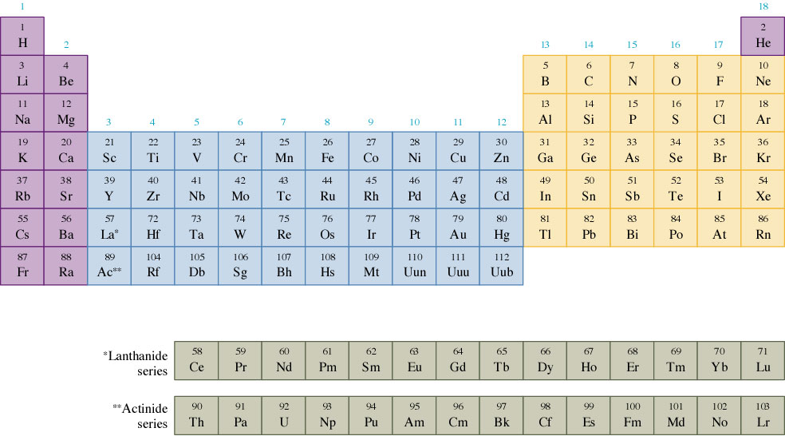

Slide 70
Condensed Form Example
Cs = 55 e-
Noble gas before it is Xenon Xe= 54e-
[Xe]
We still need 1 more e- so we write it in
[Xe] 6s¹

Slide 71
Xe
Cs

Slide 72
Question?
What is the condensed electron configuration for Selenium?

Slide 73
Answer
Se = 34 e-
[Ar] 4s² 3d¹⁰ 4p⁴

Slide 74
Ar
Se

Slide 75
EXCEPTION ALERT!!!
Memorize the EC of Copper and Chromium. They are exceptions to our rules due to stability
Chromium [Ar] 4s¹3d⁵
Copper [Ar] 4s¹3d¹⁰

Slide 76
EXCEPTION ALERT
After Lanthanum [Xe]6s²5d¹ we start filling 4f

Slide 77
EXCEPTION ALERT
After Actinium [Rn]7s²6d¹ we start filling 5f

Slide 78
Homework
Pg 342
#’s 70, 75, 77, 80, 82

Slide 79
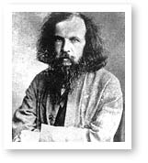
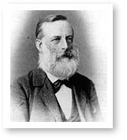
7.12 Periodic Trends
1869 Mendeleev & Meyer publish nearly identical classifications of elements.
Mendeleev
Meyer

Slide 80
Insisted that elements with similar characteristics be groups into families.
He left blanks spaces for unknown elements and predicted their physical properties.
In 1913 Mosley developed the concept of atomic numbers that we use today to classify elements.

Slide 81
Periodicity
The valence electron structure of atoms can be used to explain various properties of atoms.
In general properties correlate down a group and across a period.

Slide 82
Periodicity Vocabulary
Valence Electrons: Outermost electrons. Requires less energy to remove due to increased distance from the nucleus and positive protons.
Core Electrons : An inner electron in an atom. Harder to remove due to strong bond between positive nucleolus

Slide 83
Periodic Trends
atom size
1st ionization energy
electron affinity
electronegativity
H
He
Li Mg B C N O F Ne
Na Mg Al Si P S Cl Ar
K Ca Sc Ti V Cr Mn Fe Co Ni Cu Zn Ga Ge As Se Br Kr
Rb Sr Y Zr Nb Mo Tc Ru Rh Pd Ag Cd In Sn Sb Te I Xe
Cs Ba La Hf Ta W Re Os Ir Pt Au Hg Tl Pb Bi Po At Rn
Fr Ra Ac Rf Db Sg Bh Hs Mt Ds
Ce Pr Nd Pm Sm Eu Gd Tb Dy Ho Er Tm Yb Lu
Th Pa U Np Pu Am Cm Bk Cf Es Fm Md No Lr

Slide 84
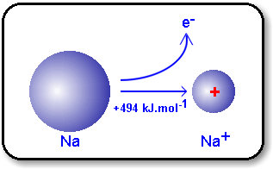
Ionization Energy
Energy required to remove one electron from an atom.
The greater the propensity for an atom to hold onto an electron the higher the ionization energy required to remove that electron.
Note the size in electron clouds

Slide 85
Ionization Energy cont.
First Ionization Energy (I₁): Energy required to remove the first electron from an atom in the ground state (no charge)
Second Ionization Energy(I₂):Energy required to remove the second electron from an atom (X⁺)
Table 7.6 pg 330

Slide 86
Trends in Ionization
One can perform multiple ionizations
Al (g) → Al⁺ +e- I₁ = 580 kJ/mol
Al⁺ (g) → Al²⁺ +e- I₂ = 1815 kJ/mol
Al²⁺ (g) → Al³⁺ +e- I₃ = 2740 kJ/mol
I₄ ₌ 11,600 kJ/mol
I₁ < I₂ < I₃

Slide 87
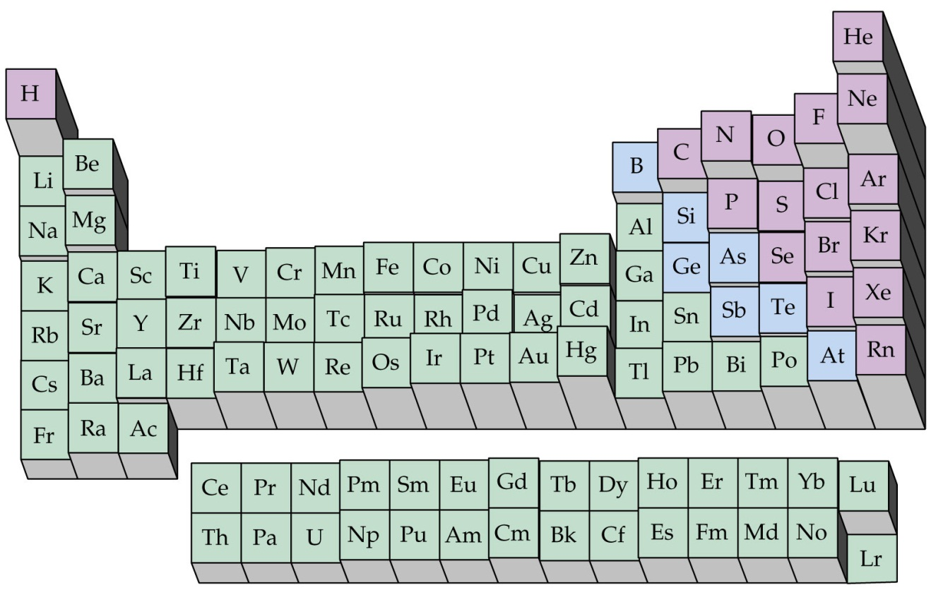
Periodic Table - Trends
ionization energy
+
-
Ionization energy increases across a period
And decreases down a group

Slide 88
Vocabulary
Effective nuclear charge:
The amount of positive charge acting on an electron.
(# of p+ in the nucleus) – (# of e- in between the nucleus and the electron in question)
Basically, the nucleus attracts an electron, but other electrons in lower shells repel it (opposites attract, likes repel).
Shielding Effect
The shielding (or screening) effect is similar to effective nuclear charge. The core electrons repel the valence electrons to some degree. The more electron shells there are (a new shell for each row in the periodic table), the greater the shielding effect is. Essentially, the core electrons shield the valence electrons from the positive charge of the nucleus.

Slide 89
(PES Explanation!) Ionization decreases going left across a period because there is a lower effective nuclear charge ( due to less p+ in the nucleus) keeping the electrons attracted to the nucleus, so less energy is needed to pull one out
It decreases going down a group due to the shielding effect. Remember Coulomb's Law: as the distance between the nucleus and electrons increases, the pull form the nucleus decreases. we call this a coulombic effect.

Slide 90
NOTE:
You will see a large SPIKE in energy when you begin to remove core electrons.
https://www.youtube.com/watch?v=NRIqXeY1R_I&noredirect=1
See # 19, 20 in chapter 3 AP

Slide 91
CONCEPT CHECK!
Which atom would require more energy to remove an electron? Why?
Na Cl
Notes:
Cl would require more energy to remove an electron because the electron is more tightly bound due to the increase in effective nuclear charge.

Slide 92
CONCEPT CHECK!
Which atom would require more energy to remove an electron? Why?
Li Cs
Notes:
Li would require more energy to remove an electron because the outer electron is on average closer to the nucleus (so more tightly bound).

Slide 93
Removing Valence and Core Electrons
Na (g) → Na⁺ (g) + e- I₁ = 495 kJ/mol
[Ne]3s¹ [Ne] (removing valence e- )
Na⁺ (g) → Na²⁺ (g) + e- I₂ = 4560 kJ/mol
[Ne] 1s²2s²2p⁵ (removing core electrons)
* It takes significantly more energy to remove core electrons

Slide 94
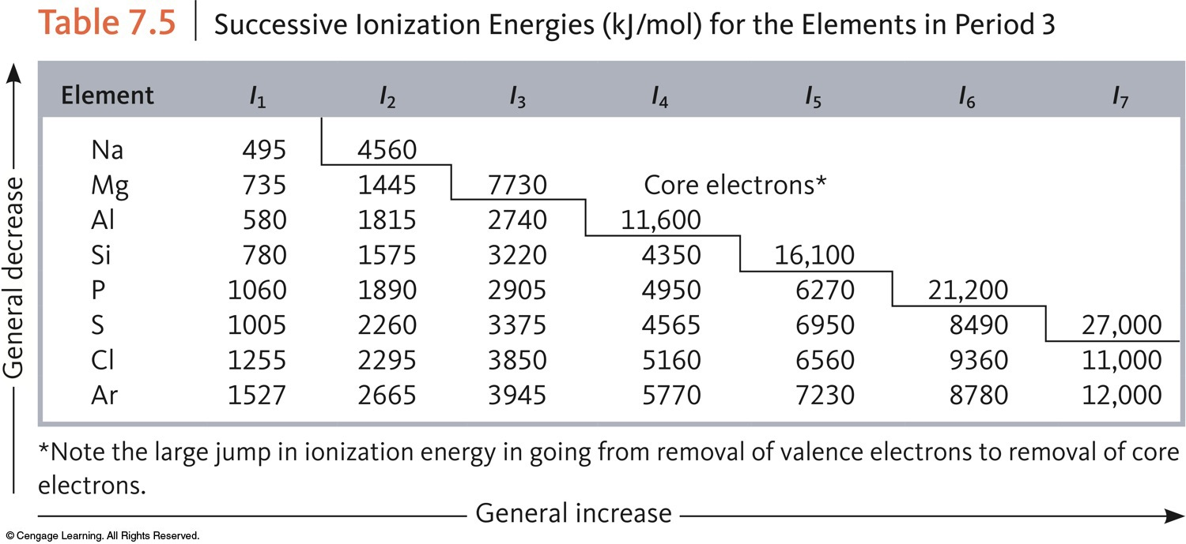
Successive Ionization Energies (KJ per Mole) for the Elements in Period 3

Slide 95
CONCEPT CHECK!
Which has the larger second ionization energy? Why?
Lithium or Beryllium
Notes:
Lithium has the larger second ionization energy because then a core electron is trying to be removed which will require a lot more energy than a valence electron.

Slide 96
Electron Affinity
The energy change (ΔE) associated with the addition of an electron.
(affinity for chocolate)
X(g) + e⁻ → X⁻(g)

Slide 97
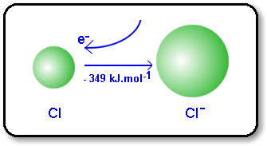
Electron Affinity
A negative ΔE indicates a strong attraction between atom and the added electron. The stronger the attraction the more energy will be released because we are making the atom more stable.
Cl + e- → Cl⁻ ΔE = -349kJ/mol

Slide 98
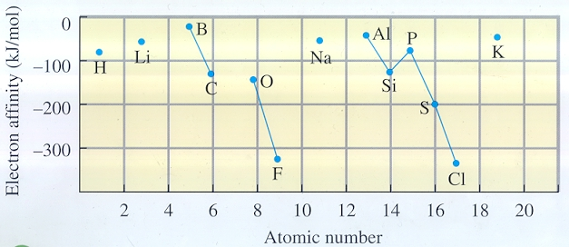

Slide 99
Periodic Table - Trends
Electron Affinity
+
More negative ΔE
-
More positive ΔE

Slide 100
Which of the indicated three elements has the least favorable E_{ea}, and which has the most favorable E_{ea}?

Slide 101
Atomic Radii
Allows us to determine the bond lengths between two covalently bonded atoms.
Ex: the Br-Br bond distance of Br₂ is 228 ppm therefore the atomic radius of Br is
228/2 = 114 ppm

Slide 102
Atomic Radius of a Metal
To play movie you must be in Slide Show Mode
PC Users: Please wait for content to load, then click to play
Mac Users: CLICK HERE

Slide 103
Periodic Table - Trends
Atomic Radii
-
+

Slide 104
Shielding
Moving down the periodic table the number of Ve stays the same but the number of core electrons increases.
Atomic radios increase down a group because the increase in core electrons SHEILDS the valence electrons form the nucleus allowing them to pull farther away.

Slide 105
The Why
There is a correlation between atomic radii and the principle quantum number n.
As n increases atomic radii increases due to the e- moving farther and farther away from the nucleus, pulling on the e- less and less and allowing them to spread out and be less dense.
n = 2 n = 5

Slide 106
Moving down the PT
Moving left to right the number of protons increases so the pull on the electrons form the nucleus increase this decreases the atomic radius.
Yes electrons are being added…BUT they are all in the same shell about the same dissonance form the nucleus so there is not much shielding.

Slide 107
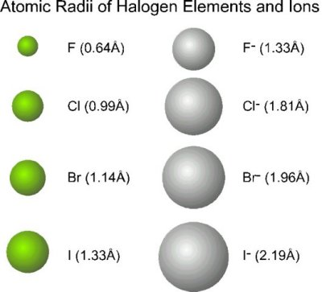
Radii of Ions
Size of ions is based o the distance between the ions in the ionic compound
Would you expect the cations of these elements to be larger or smaller than the ground state atom?

Slide 108
CONCEPT CHECK!
Which should be the larger atom? Why?
Na Cl
Notes:
Na should be the larger atom because the electrons are not bound as tightly due to a smaller effective nuclear charge.

Slide 109
CONCEPT CHECK!
Which should be the larger atom? Why?
Li Cs
Notes:
Cs should be the larger atom because of the increase in orbital sizes in successive principal quantum levels (to accommodate more electrons).

Slide 110
EXERCISE!
Arrange the elements oxygen, fluorine, and sulfur according to increasing:
Ionization energy
S, O, F
Atomic size
F, O, S
Notes:
Ionization Energy: S, O, F (IE increases as you move up a column and to the right across a period.)
Atomic Size: F, O, S (Atomic radius increases as you move to the left across a period and down a column.)

Slide 111
Electronegativity
How strongly the nucleus attracts the electrons of OTHER atoms in a bond.
EN increases
Decreases

Slide 112
Homework
Pg 343 #’s 84, 86,87, 88, 94, 96, 97, 101

