Slide 1
Gases
5/75 Questions in multiple choice
Almost every year in free response section

Slide 2
5.1 Gas Pressure
Gases exert pressure on any surface they come in contact with.
Pressure is related to the number of collisions the gas molecules have with wall of a container per unit of area per unit of time.
Pressure = Force / Area

Slide 3
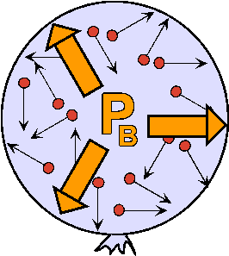
The force of impact of a single collision is too small to be sensed. Taken all together, this large number of impacts of gas molecules exerts a large force on a surface
The larger the number of collisions per area of enclosure, the larger the pressure:

Slide 4
Units for Pressure
The SI-unit of pressure is Pascal [Pa]
Atmospheres (atm)
Millimeters of Mercury (mmHg)
Torr (torr)
Pressure per square inch (Psi) = lbs/in²
1atm = 760 mmHg = 760 torr
1atm = 76cmHg
1 atm = 1.013 x10⁵ Pa
1 atm = 14.69 psi

Slide 5
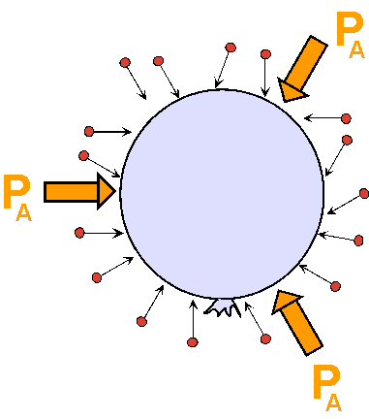
Types of Pressure

Slide 6
5.2 Boyles Law Demo
lets assume that the balloon is tight, so that the amount or mass of air in it stays the same
Density = mass/ volume,
the gas density of the balloon thus varies only with its volume (when mass is held constant).
If we squeeze the balloon, we compress the air and two things will happen:
the air pressure in the balloon will increase.
the density of the air in the balloon will increase.
Since density is mass over volume, and the mass stays constant, the rise in density means that the volume of the balloon decreases: pressure goes up (↑); volume goes down (↓)
Pressure and volume are inversely proportional

Slide 7
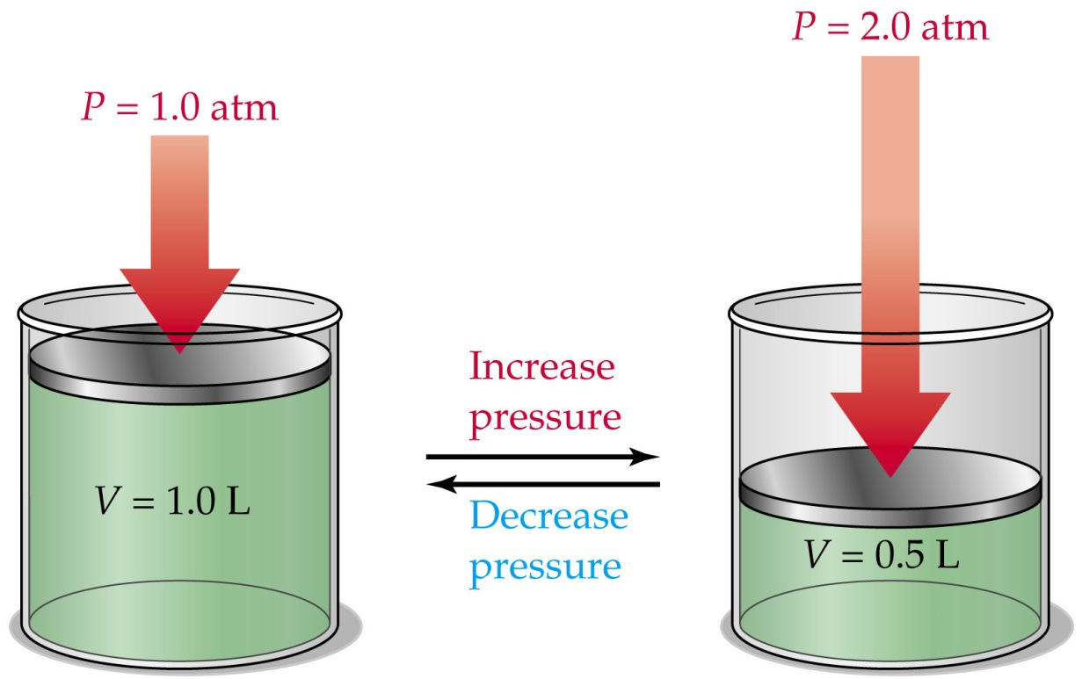
Boyle’s Law
P ↓
V ↑
P ↑
V ↓
At a constant temperature and a fixed quantity of gas pressure and volume are inversely proportional.
P₁ V₁ = P₂ V₂ ( 1 = initial 2 = final)

Slide 8
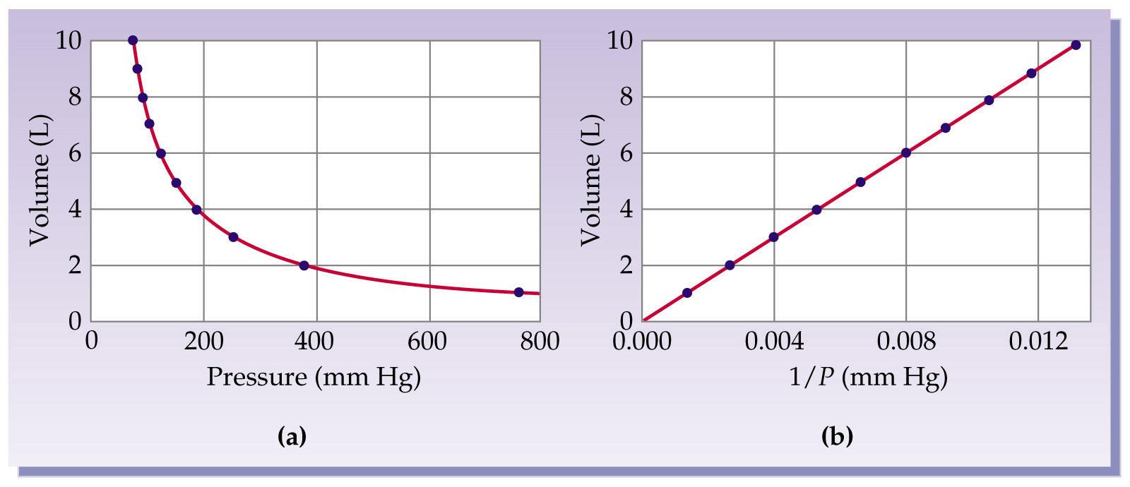
Graphical Explanation
At a constant temperature and a fixed quantity of gas pressure and volume are inversely proportional.
P₁ V₁ = P₂ V₂ ( 1 = initial 2 = final)

Slide 9
Boyle’s Example
Mini Lab

Slide 10
Example
A 3.0L bulb containing He at 145 mmHg is connected by a value to a 2.0 L bulb containing Argon gas at 335 mmHg. Calculate the partial pressure of each gas and the total pressure after the valve between the flasks is opened.
3.0 L
He 145 mmHg
2.0 L Ar
355 mmHg

Slide 11
Answer
First we need to find the total volume of the bulbs:
V_{total} = V_{a} +V_{b} = 3+2=5
Next we need to do Boyles’s law twice, once for each bulb to find P of each gas. P₁ V₁ = P₂ V₂
He: 145(3) = P₂ (5) Ar = 355 (2) = P₂ (5)
P₂ =87 mmHg P₂= 142 mmHg

Slide 12
Answer Cont.
He: 145(3) = P₂ (5) Ar: 355 (2) = P₂ (5)
P₂ =87 mmHg P₂= 142 mmHg
Now we need to find the pressure after the valve between the two flasks is opened.
P_{total}= P_{2He} +P_{2Ar}
= 87 + 142
= 229 mmHg

Slide 13
Bonus
Convert 229 mmHg to atm
229 mmHg x 1 atm = 0.303 atm
760 mmHg

Slide 14
Charles's Law Demo
By warming the balloon up, we increase the speed of the moving gas molecules inside it.
This increases the rate at which the gas molecules hit the wall of the balloon.
Because the balloon’s skin is elastic, it expands upon this increased pushing from inside, and the volume taken up by the same mass of gas increases with temperature.

Slide 15
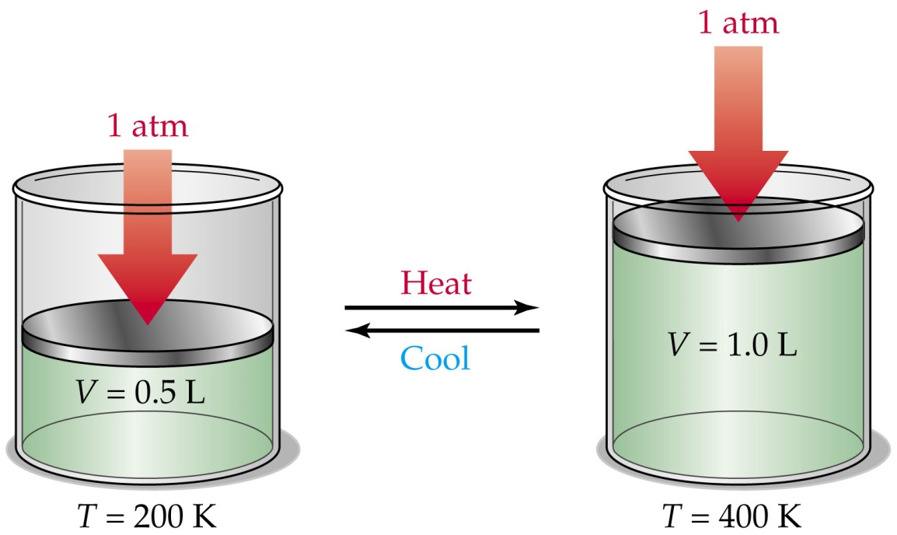
Charles's Law
At constant pressure the volume of gas is direct proportional to its temperature.
V₁ = V₂
T₁ T₂
Note: Temp is ALWAYS in Kelvin!!!!
T ↑
V ↑
T ↓
V ↓

Slide 16
Charles's Law Mini Lab
Mini Lab

Slide 17
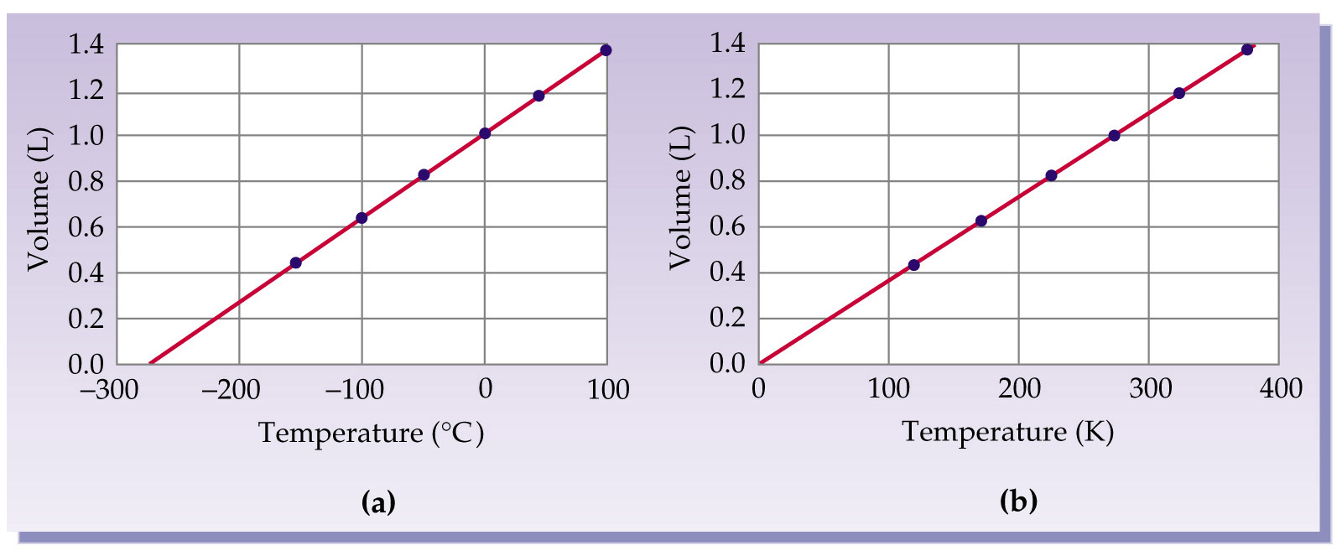
Graphical Explanation

Slide 18
Charles's Law Example
A balloon is filled to a volume of
7.00 x 10²ml at a temperature of 20.0◦C. The balloon is then cooled at a constant pressure to a temperature of 1.0x10²K.
What is the final volume of the balloon?

Slide 19
Answer
20C + 273 = 293 K
7.00 x 10²ml = V₂
293 K 1.0x10²K.
V₂= 238.9 ml

Slide 20
Avogadro’s Law
Equal volumes of gas at the same temperature and pressure contain equal numbers of moles.
If temperature and Pressure are constant Volume of a gas is directly proportional to the number of moles.
Notes:
Poroptional to the

Slide 21
Avogadro’s Law
V ↓
n ↓
V ↑
n ↑
At constant temperature and Pressure the Volume of a gas is directly proportional to the number of moles.
V₁ = V₂ n₁ n₂

Slide 22
Example
How many liters of O₂ gas are required to prepare 100 L of CO₂ gas by the following reaction.
2 CO (g) + O₂ (g) 2 CO₂ (g)

Slide 23
Answer
V1 = V2 n1 n2
100 = V₂
1
V₂= 50L

Slide 24
Homework
Write out the formulas for
Boyle, Charles's, and Avogadro 5 times each
Then do problems
Pg: 232-233 23, 29, 31, 32

Slide 25
Combined Gas Law
This is used when nothing is constant in an experiment.
P₁V₁ = P₂V T₁ T₂
P = atm
V = L
T = K
P | V | T
CONSTANT | ↑ | ↑
↑ | ↓ | CONSTANT
↑ | CONSTANT | ↑

Slide 26
Example
A gas is contained in a cylinder with a temperature of 281 K and a volume of 2.1 ml at a pressure of 6.4 atm. The gas is heated to a new temperature of 298 K and the pressure decreases to 1 atm.
What is the new volume of the gas.

Slide 27
Answer
P₁V₁ = P₂V₂
T₁ T₂
P₁= 6.4atm
V₁ = 2.1 ml
T₁ = 281 k
P₂= 1 atm
V₂= ?
T₂ = 298 K
6.4 (2.1) = 1 (V₂)
281 298
V₂ = 14ml

Slide 28
STP
Standard Temperature and Pressure
P = 1 atm = 760 torr
T = 273 K , (0⁰C)
The volume occupied by 1mole of ideal gas at STP = 22.4 L
Trick: they won’t always give you 1 mole of gas!!!

Slide 29
STP Question
What would be the volume at STP of 4.06 L of nitrogen gas, at 715 torr and 28ºC ?

Slide 30
Answer
P₁V₁/T₁ = P₂V₂/T₂

Slide 31
Ideal Gas Law 10.4
Ideal gas: a hypothetical gas whose pressure (atm), volume (L), and temperature (K) behave as predicted every time. (Perfect like each and everyone of you!)
Ideal Gas Law: PV = nRT
gas constant:
R= 0.0821 L x Atm/mol x K

Slide 32
Example
A 50.0L cylinder of acetylene C₂H₂ has a pressure of 17.1 atm at 21C . What is the mass of acetylene in the cylinder.

Slide 33
Answer
PV = nRT
21 + 273 = 294 K
17.1 (50.0) = n (0.0821) (294)
n = 35.4 mol
Need answer in grams
35.4 C₂H₂ x 26g C₂H₂ = 920 g C₂H₂
1 mol C₂H₂

Slide 34
A short Way to do that
mw = mRT
VP
An unknown gas weighs 34g and occupies 6.7L at a pressure of 2 atm at temperature of 245K.What is its average molecular weight.

Slide 35
Answer
51 g/mol

Slide 36
Dalton’s Law of Partial Pressures
The total pressure of a mixture of gases is the sum of the pressure of all of the gases.
P_{total} = P₁ + P₂+ P₃ ……

Slide 37
Partial pressure of a gas is directly proportional to the number of moles of gas.
EX: if 25% of a gas mixture is He, then the partial pressure due to the He will be 25% of the total pressure
P_{a} = (P_{total}) (X_{a})
X_{a} = moles of gas A / total moles of the gas

Slide 38
Homework
Pg 233: 45,47,56,61,69

Slide 39
Mole Fraction (X₁)
The ratio of the number of moles of a given component in a mixture to the total number of moles in the mixture.
X₁ = n₁
n₁ +n₂ +n₃
n = moles = PV/RT

Slide 40
Kinetic Molecular Theory
Gases consist of large numbers of molecules that are continuously in random motion.
The volume of a molecule of gas is negligible, compared to total volume of gas.
Attractive and repulsive forces between gas molecules are negligible.

Slide 41
Kinetic Molecular Theory
Average kinetic energy of gas is constant at constant temperature.
The average kinetic energy of a collection of gas particles is assumed to be directly proportional to the Kelvin temperature of the gas.

Slide 42
Kinetic Molecular Theory
The theory gives us an understating of both pressure and temperature at a molecular level.
As temp increases K.E increases.
If temp doubles K.E doubles
The greater the temperature the greater the average kinetic energy of the gas

Slide 43
KMT
If several gases are present in a sample at a given temp, all of the gases, regardless of identify will have the same average kinetic molecular energy.
There are no forces of attraction between gas molecules in an ideal gas.
Gas molecules are in constant motion

Slide 44
Total kinetic energy of a gas sample
R = gas constant 8.31 joules/mol-K
(0.0821 L x Atm/mol x K)
n = # moles
T = temp in K

Slide 45
Average kinetic energy of a single gas molecule at a given temparture
m = mass of molecule in kg
٧ = is the speed of the molecules in m/s
K.E = joules

Slide 46
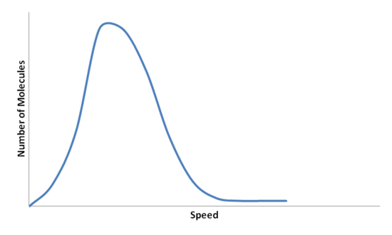
Maxwell-Boltzmann Distribution Function
Figure 1 shows the Maxwell-Boltzmann Distribution of speeds for a certain gas at a certain temperature, such as nitrogen at 298 K. The speed at the top of the curve is called the most probable speed because the largest number of molecules have that speed.

Slide 47
Maxwell-Boltzmann Distribution is affected by temperature
At lower temperatures, the molecules have less energy. Therefore, the speeds of the molecules are lower and the distribution has a smaller range. As the temperature of the molecules increases, the distribution flattens out. Because the molecules have greater energy at higher temperature, the molecules are moving faster.

Slide 48
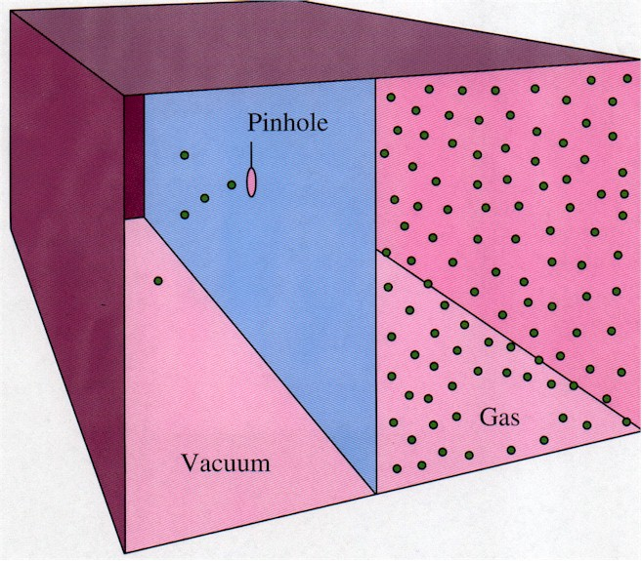
5.7 Effusion – Diffusion
Effusion:
The rate at which a gas
Is able to escape through a tiny hole.
Effusion:
The rate at which a gas
Is able to escape through a tiny hole.
Effusion:
The rate at which a gas
Is able to escape through a tiny hole.

Slide 49
Grahams law of effusion
Used to compare the avg, speed (rate of effusion) of two different gasses in a sample.
M = molar mass of gas
r = rate of effusion of a gas or avg. speed of molecule.

Slide 50
Diffusion
Diffusion:
the spread of one substance throughout a second substance.

Slide 51
Van der Waals Equation
P = atm T = absolute temp of gas K
V = L R = 0.0821 l-atm/mol-K
n = moles
a = a constant different for each gas that takes into account attractive forces. (given)
b= a constant different for each gas that takes into account volume (size) of each molecule. (given)

Slide 52
What does Van der Waals do?
Van der Waals equation adjusts the ideal gas law and kinetic molecular theory to take into account these non-ideal gases (gases at low temperatures and high pressures.)

Slide 53
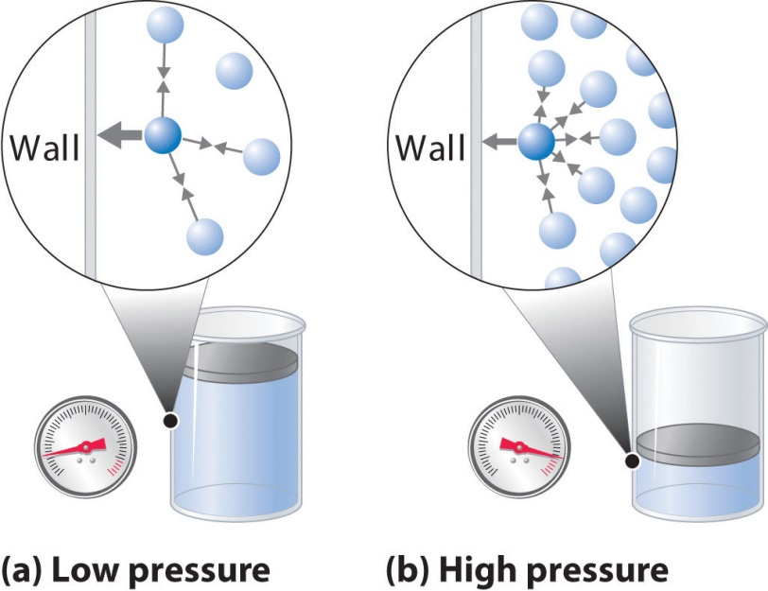
Van der Waals equation (yes 2 a’s )
At ↑pressure there is less space between gas molecules so the volume of the molecules themselves becomes more relevant.

Slide 54
At low temperatures gases become VERY tightly packed due to less K.E. ideal way because with out high K. E they become susceptible to attractive forces between gas molecules which could cause the molecules to condense.
thus the ideal gas law fails us at high pressures and low temperatures….
Van Der Waals to the rescue!

Slide 55
AP Examples
Q1 Which of the following gases would you expect to have the largest value for van Der Waals constant b?
H₂ N₂ CH₄ C₂H₆ C₃H₈
Q2 Which of the following gases would you expect to have the largest value for van Der Waals constant a?
H₂ N₂ CH₄ CO₂

Slide 56
Answer
Q1 b measures the size of molecules so the largest molecule would have the largest b C₃H₈
Q2 a measures the intermolecular forces of attraction so the most ionic/polar molecule would have the largest a
CO₂

Slide 57
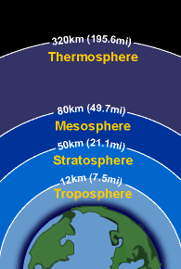
Chemistry in the atmosphere
Principle components
NO₂, O₂, H₂O, CO₂
N₂ Troposphere
Chemistry in the troposphere is most influenced by human activities.

Slide 58
Pollution
Long term effects on weather patterns
Sources:
Combustion of petroleum (CO₂, CO, NO, NO₂)

Slide 59
Dangerous Reactions
NO₂ (g) → NO (g) + O (g)
O (g) + O₂ (g) → O₃ (g) ozone
Radiant heat

Slide 60
Why Ozone stinks
Can react directly with other pollutants
Can absorb light and break up to form hydroxyl radicals that are oxidizing agents.
Hydroxyl radicals are a danger to your repertory system and mucus membranes.

Slide 61
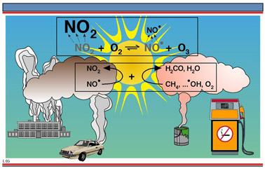
Photochemical smog
Photochemical smog is a type of air pollution produced when sunlight acts upon motor vehicle exhaust gases to form harmful substances such as ozone (O₃)

Slide 62
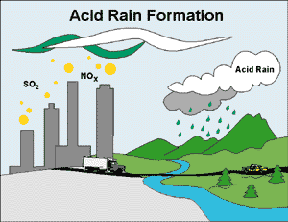
Burning Coal
S (in coal) + O₂ (g) → SO₂ (g)
SO₂ (g) + H₂O → H₂SO₄ (Acid Rain)

Slide 63
Homework
Pg 232
71,7377,79
Princeton review problem 1 and 2 on pg 94
\

