Slide 1
Chapter 12 in test and Princeton Review

Slide 2

KINETICS
The area of chemistry concerned with the rates at which chemical reactions occur.
How fast are reactants turning into products and visa versa.

Slide 3
Time it Takes to build a brick wall
1. Pick up bricks
2. deliver bricks
3. unload bricks
4. build wall

Slide 4
REACTION RATE
The change of the concentration of reactants or products over time.
Usually measured in M/sec.

Slide 5
4 MAJOR FACTORS THAT AFFECT REACTION RATE
Concentration of reactants
Concentration of a catalyst
Temperature
Surface area of a solid reactant or catalyst

Slide 6

CONCENTRATION OF REACTANTS
The rate of most reactions increases when the concentration of a reactant is increased.

Slide 7
Catalysts
Increases the rate of the reaction with out being consumed in the process.
They do not appear in the balance equation
They are necessary for some reactions to even occur
Increase rate of reaction by providing an alternative pathway for the reaction to occur with a lower activation energy.

Slide 8
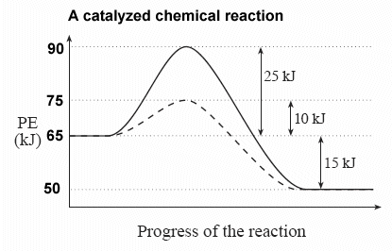
uncatalyzed
catalyzed
E_{a}
E_{a}
ΔH
ΔH for both reactions are 15 kJ (ΔH is a state function and INDEPENDENT of pathway)
E_{a} is pathway DEPENDENT and is different for both reactions.

Slide 9
CONCENTRATION OF A CATALYST
The rate of a chemical reaction increases with the concentration of a positive catalyst.
Not all catalysts are created equal some can boost one reaction and hinder another.

Slide 10
TEMPERATURE
Generally speaking, reaction rate increases as temperature increases.
Think Kinetic Molecular Theory

Slide 11
SURFACE AREA OF A SOLID REACTANT OR CATALYST
If a reaction involves a solid with a gas or liquid, the rate of reaction increases as the surface area increases.

Slide 12
EXPRESSING AVERAGE REACTION RATE WITH RESPECT TO REACTANTS
I⁻ _{(aq)} + ClO⁻ _{(aq)} → Cl⁻ _{(aq)} + IO⁻ _{(aq)}
Since the concentration of a reactant
(I⁻ _{(aq)}) decreases with time (i.e. its consumed by the reaction), if we express the reaction rate with respect to a reactant,
Avg rate = - ∆ [ I⁻ ] /∆ time

Slide 13
EXPRESSING AVERAGE REACTION RATE WITH RESPECT TO PRODUCTS
I⁻ _{(aq)} + ClO⁻ _{(aq)} → Cl⁻ _{(aq)} + IO⁻ _{(aq)}
Since the concentration of products increases with time (i.e. they are formed)
Avg rate = ∆ [IO⁻] / ∆ t

Slide 14
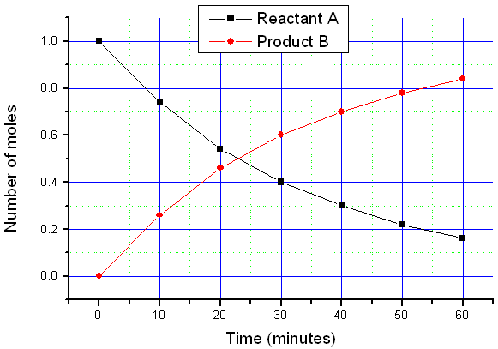

Slide 15
REACTION RATES AND STOICHIOMETRY
Given the following data, calculate the average rate of reaction in (M/s) with respect to C₄H₉Cl, for the 1st 50 seconds.
-1.9 x 10 ⁻⁴ M/s
TIME (s) | [C₄H₉Cl] (M)
0 | 0.1000
50.0 | 0.0905
100.0 | 0.0820
150.0 | 0.0741
200.0 | 0.0671
300.0 | 0.0549

Slide 16
REACTION RATES AND STOICHIOMETRY
Calculate the average reaction rate, with respect to C₄H₉Cl, for the 2nd 50 seconds.
-1.7 x 10⁻⁴ M/s
TIME (s) | [C₄H₉Cl] (M)
0 | 0.1000
50.0 | 0.0905
100.0 | 0.0820
150.0 | 0.0741
200.0 | 0.0671
300.0 | 0.0549

Slide 17
INSTANTANEOUS RATE OF RXN
In the previous problem, we have calculated the average reaction rate during a specified period of time.
If we plot [reactant] on y-axis and time on the x-axis we can determine the instantaneous rate of rxn.
Draw a straight line tangent that touches the curve at the pt. of interest (specified time). The slopes of tangents give the instantaneous rates at those times. (this is calculus)

Slide 18
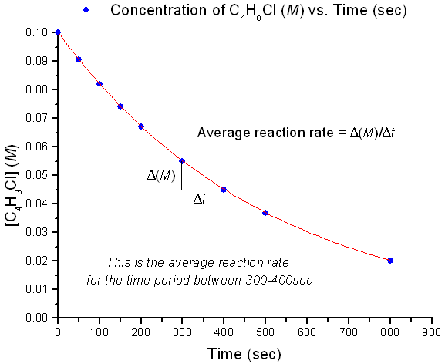
Instantaneous Rate

Slide 19
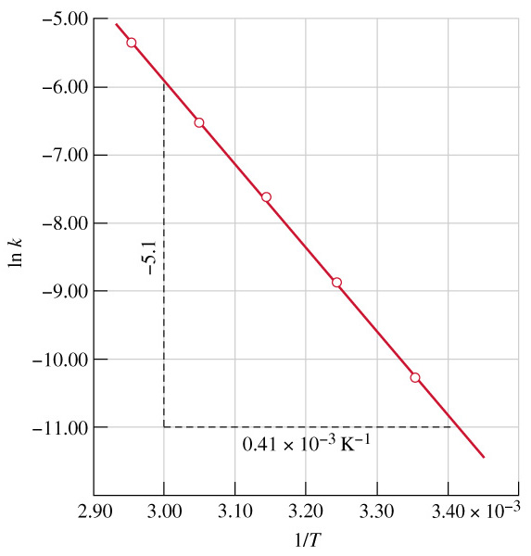

Slide 20
Types of Rate Laws
Differential Rate Law (rate law) – shows how the rate of a reaction depends on concentrations.
Integrated Rate Law – shows how the concentrations of species in the reaction depend on time.

Slide 21
RXN RATES AND STOICHIOMETRY
Because the amounts of products and reactants are related by stoichiometry, any substance in the reaction can be used to express the rate of reaction in relationship to time.
rate = 1/[A]/∆ t

Slide 22
RXN RATES AND STOICHIOMETRY
Note that reactants are disappearing
In general, for the reaction
aA + bB → cC + dD
Rate = (- 1/a)(Δ[A]/Δt) = (-1/b)(Δ[B]/Δt) = (1/c)(Δ[C]/Δt) = (1/d)(Δ[D]/Δt)
Tells us how the rate of the reaction depends on concentration

Slide 23
RXN RATES AND STOICHIOMETRY
2 O_{3 (g)} → 3 O_{2 (g)}
How is the rate of disappearance of ozone related to the rate of appearance of oxygen in the above?
Rate =(-1/ 2) (∆[O₃]/∆t) = (1/ 3) (∆[O₂] ]/∆t)
Disappearance Appearance

Slide 24
RXN RATES AND STOICHIOMETRY
2 O_{3 (g)} → 3 O_{2 (g)}
If the rate of appearance of oxygen (O₂ ) is
6.0 x 10⁻⁵ M at a particular instant, what is the value of the rate of disappearance of ozone (O₃ ) at this same time?

Slide 25
RXN RATES AND STOICHIOMETRY
2 O_{3 (g)} → 3 O_{2 (g)}
Rate = (-1/2)(∆[O₃]/∆t) = (1/3)(∆[O₂]/∆t)
- ∆ [O₃]/∆t = (2/3)(∆[O₂]/∆t)
(2/3)(6.0 x 10⁻⁵ M/s) = - ∆[O₃]
4.0 x 10⁻⁵ M/s

Slide 26
The Rate Law
The rate law expresses the relationship of the rate of a reaction to the rate constant (k) and the concentrations of the reactants raised to some powers.
aA + bB cC + dD
Rate = k [A]^{x}[B]^{y}
reaction is xth order in A
reaction is yth order in B
reaction is (x +y)th order overall
*The greater the value of the exponent the greater the change in concentration of that reactant
13.2

Slide 27
Method of Initial Rates
The value of the initial rate is determined for each experiment at the same value of t as close to t = 0 as possible.
Several experiments are carried out using different initial concentrations of each of the reactants, and the initial rate is determined for each run.
The results are then compared to see how the initial rate depends on the initial concentrations of each of the reactants.

Slide 28
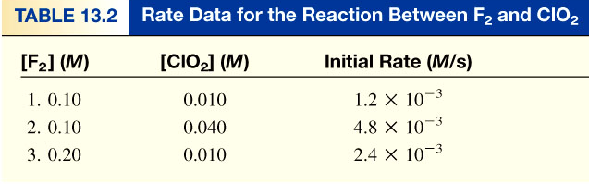
F₂ (g) + 2ClO₂ (g) 2FClO₂ (g)
rate = k [F₂]^{x}[ClO₂]^{y}
Double [F₂] with [ClO₂] constant
Rate doubles
[2] ^{x} = 2 x = 1
Conc initial rate order of rxn
rate = k [F₂][ClO₂]
Quadruple [ClO₂] with [F₂] constant
Rate quadruples
[4] ^{y} = 4 y =1
13.2

Slide 29
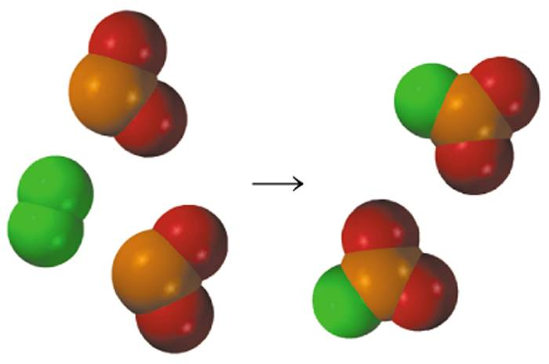
Rate Laws
Rate laws are always determined experimentally.
Reaction order is always defined in terms of reactant (not product) concentrations.
The rate law of a reactant is not related to the stoichiometric coefficient of the reactant in the balanced chemical equation.
Tells us how the rate depends on concentration
F₂ (g) + 2ClO₂ (g) 2FClO₂ (g)
1
rate = k [F₂][ClO₂]
13.2

Slide 30
Determine the rate law and calculate the rate constant (k) for the following reaction from the following data:
S₂O₈²⁻ (aq) + 3I⁻ (aq) 2SO₄²⁻ (aq) + I₃⁻ (aq)
Experiment | [S₂O₈²⁻] | [I⁻] | Initial Rate (M/s)
1 | 0.08 | 0.034 | 2.2 x 10⁻⁴
2 | 0.08 | 0.017 | 1.1 x 10⁻⁴
3 | 0.16 | 0.017 | 2.2 x 10⁻⁴
rate = k [S₂O₈²⁻]^{x}[I⁻]^{y}
y = 1
x = 1
rate = k [S₂O₈²⁻][I⁻]
Double [I⁻], rate doubles (experiment 1 & 2)
Double [S₂O₈²⁻], rate doubles (experiment 2 & 3)
rate
2.2 x 10⁻⁴ M/s
k =
=
= 0.08/M•s
[S₂O₈²⁻][I⁻]
(0.08 M)(0.034 M)
13.2

Slide 31
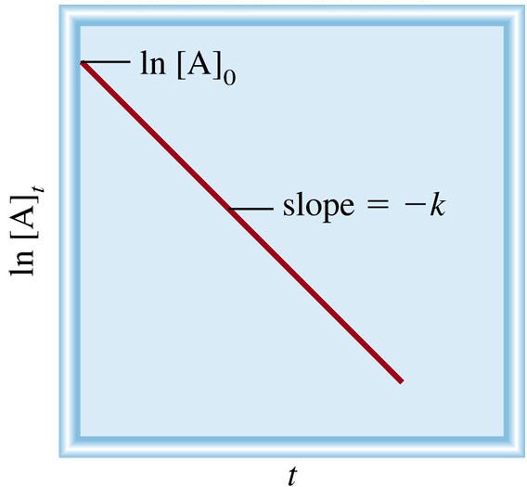
First-Order Reactions
Δ[A]
A product
rate = -
rate = k [A]
Δt
Δ[A]
rate
M/s
-
= k [A]
k =
=
= 1/s or s⁻¹
Δt
[A]
M
ln[A] = ln[A]₀ - kt
[A] is the concentration of A at any time t
[A]₀ is the concentration of A at time t=0
13.3

Slide 32
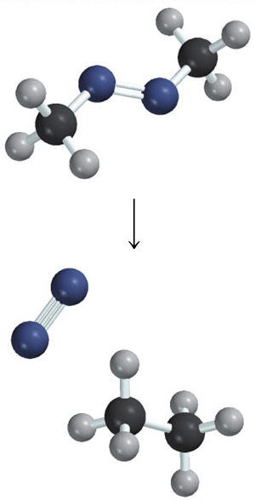
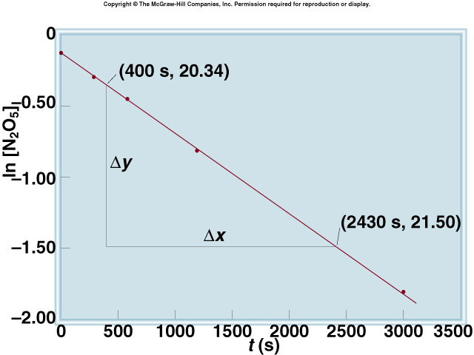
2N₂O₅ 4NO₂ (g) + O₂ (g)
13.3

Slide 33
The reaction 2A B is first order in A with a rate constant of 2.8 x 10⁻² s⁻¹ at 80⁰C. How long will it take for A to decrease from 0.88 M to 0.14 M ?
[A]₀ = 0.88 M
ln[A] = ln[A]₀ - kt
[A] = 0.14 M
kt = ln[A]₀ – ln[A]
[A]₀
0.88 M
ln
ln
ln[A]₀ – ln[A]
[A]
0.14 M
t =
=
=
= 66 s
k
k
2.8 x 10⁻² s⁻¹
13.3

Slide 34
First-Order Reactions
The half-life, t_{½}, is the time required for the concentration of a reactant to decrease to half of its initial concentration.
t_{½} = t when [A] = [A]₀/2
[A]₀
ln
[A]₀/2
ln2
0.693
t_{½}
=
=
=
k
k
k
What is the half-life of N₂O₅ if it decomposes with a rate constant of 5.7 x 10⁻⁴ s⁻¹?
ln2
0.693
t_{½}
=
=
= 1200 s = 20 minutes
k
5.7 x 10⁻⁴ s⁻¹
How do you know decomposition is first order?
units of k (s⁻¹)
13.3

Slide 35
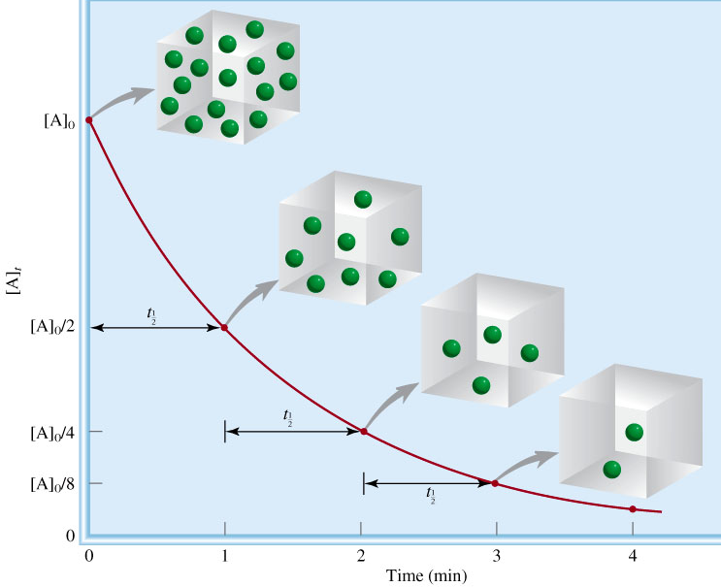
First-order reaction
A product
# of
half-lives
[A] = [A]₀/n
1
2
2
4
3
8
4
16
13.3

Slide 36
AP Add in TOYO
Half Life
Radioactive Decay
Half Life
Radioactive Decay
Balancing Nuclear Reactions

Slide 37
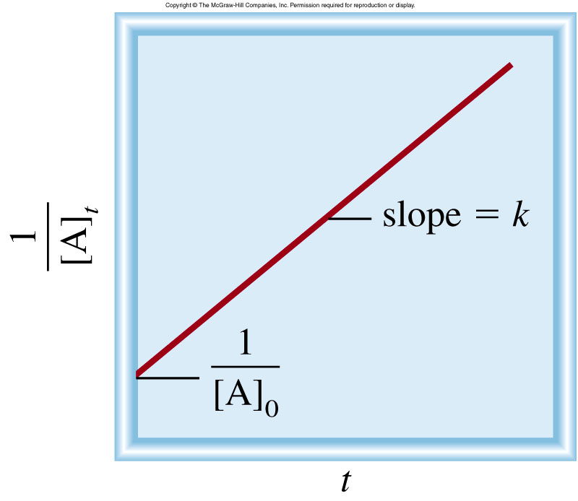
Second-Order Reactions
Δ[A]
A product
rate = -
rate = k [A]²
Δt
rate
M/s
Δ[A]
k =
=
= 1/M•s
-
= k [A]²
[A]²
M²
Δt
1
1
[A] is the concentration of A at any time t
=
+ kt
[A]
[A]₀
[A]₀ is the concentration of A at time t=0
t_{½} = t when [A] = [A]₀/2
1
t_{½} =
k[A]₀
13.3

Slide 38
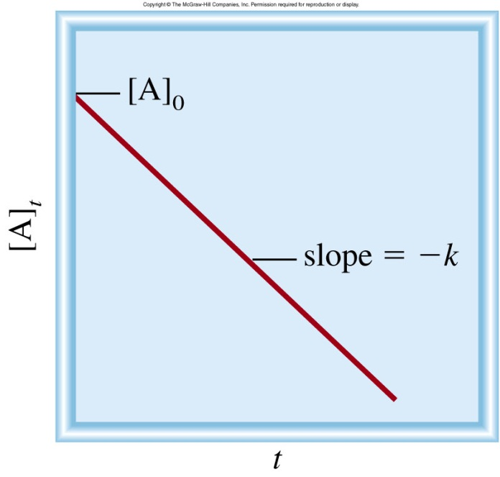
Zero-Order Reactions
Δ[A]
A product
rate = -
rate = k [A]⁰ = k
Δt
rate
Δ[A]
k =
= M/s
-
= k
[A]⁰
Δt
[A] is the concentration of A at any time t
[A] = [A]₀ - kt
[A]₀ is the concentration of A at time t=0
t_{½} = t when [A] = [A]₀/2
[A]₀
t_{½} =
2k
13.3

Slide 39

Rate Laws
To play movie you must be in Slide Show Mode
PC Users: Please wait for content to load, then click to play
Mac Users: CLICK HERE

Slide 40
Summary of the Kinetics of Zero-Order, First-Order
and Second-Order Reactions
Concentration-Time Equation
Order
Rate Law
Half-Life
[A]₀
0
rate = k
[A] = [A]₀ – kt
Units for k M/s
t_{½} =
2k
ln2
1
rate = k [A]
ln[A] = ln[A]₀ – kt
Units for k s-1
t_{½}
=
k
1
1
1
2
rate = k [A]²
=
+ kt
t_{½} =
[A]
[A]₀
k[A]₀
Units for k 1/M•s
13.3

Slide 41
Reaction order
rate = k [S₂O₈²⁻]¹ [I-]¹
[S₂O₈²⁻]¹ = first order
[I-] ¹ = first order
1+1 = 2 = second order over all

Slide 42
Sample AP Problem Series
1. Find k
2. What is concentration after
20 mins
3. What is the half life for
the reaction
Given this is a first order reaction
(we can find this… how?)
[A] M | Time min
2.0 | 0
1.6 | 5
1.2 | 10

Slide 43
1st order
ln[A]-ln[Af] =-kt
ln[1.6]-ln2.0 =-k5
K = 0.045 1/min
2.
Ln[A]-ln[2.0]=-0.045*20
[A] = e^{-0.21} = 0.81M
3. Half life 1st order = ln2/K
= 0.693/0.0451/min
= 15.4 min
[A] M | Time min
2.0 | 0
1.6 | 5
1.2 | 10

Slide 44
Homework
Pg 602
11, 14, 19

Slide 45
COLLISION THEORY OF KINETICS
Molecules must collide with sufficient energy (activation energy, E_{a}) and correct orientation relative to each other (steric factor) for a reaction to occur.

Slide 46
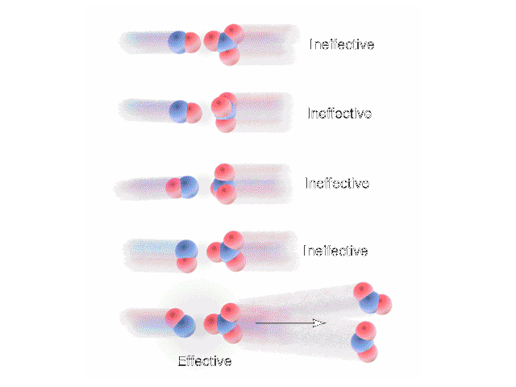

Slide 47
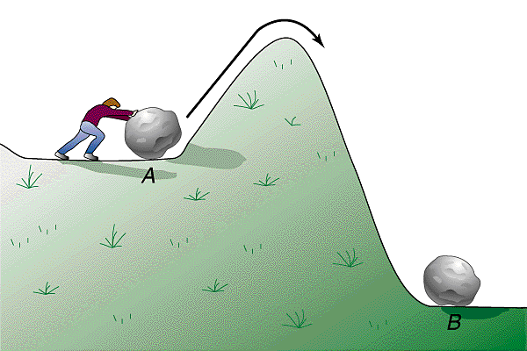
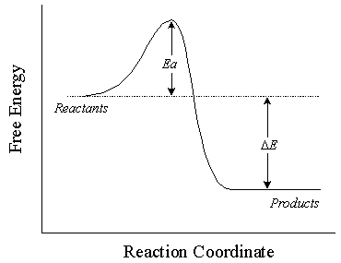
ACTIVATION ENERGY (E_{a})
The minimum amount of energy needed to start a chemical reaction.

Slide 48
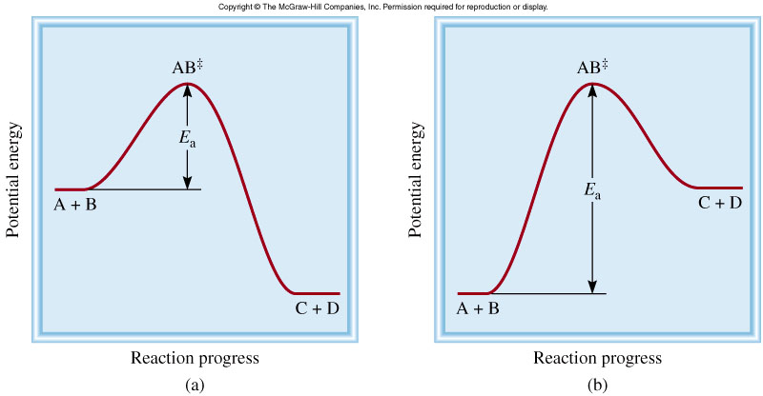
A + B AB C + D
⁺
⁺
Exothermic Reaction
Endothermic Reaction
The activation energy (E_{a} ) is the minimum amount of energy required to initiate a chemical reaction.
13.4

Slide 49
FACTORS THAT INFLUENCE NUMBER OF COLLISIONS
Concentration of reactants
  As [reactants] ↑ rxn rate ↑ due to an ↑ in probability a collision will occur
Temperature at which the reaction occurs.
  ↑ Temp = ↑ KE of molecule ↑ probability of having the right E_{a} for a rxn to occur
  So this will increase k and Rate!

Slide 50
Changes in reaction rate
Rxn rate will ↓ over time as reactants are used up.

Slide 51
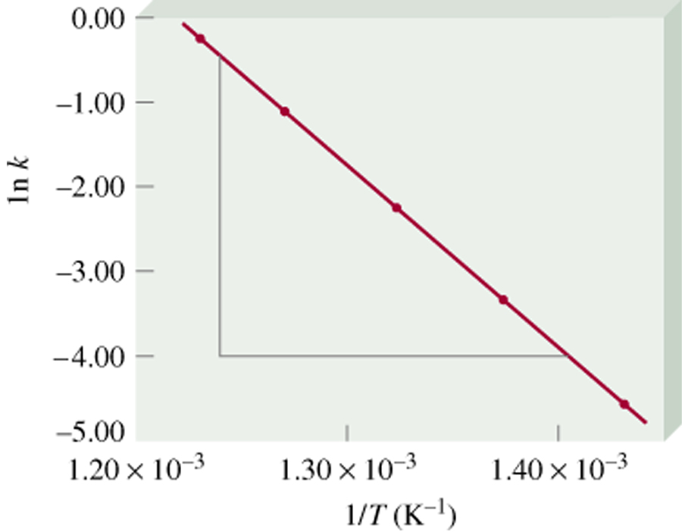
Temperature Dependence of the Rate Constant
E_{a}
1
lnk = -
+ lnA
R
T
E_{a} is the activation energy (J/mol)
R is the gas constant (8.314 J/K•mol)
T is the absolute temperature
Slope = E_{a}/R
A is the frequency factor
*****Rate constant k increases as T increases. *****
13.4

Slide 52
Reaction Mechanisms
The overall progress of a chemical reaction can be represented at the molecular level by a series of simple elementary steps or elementary reactions. (Remember Hess’s Law)
The sequence of elementary steps that leads to product formation is the reaction mechanism.
2NO (g) + O₂ (g) 2NO₂ (g)
N₂O₂ is detected during the reaction!
Elementary step:
NO + NO N₂O₂
+
Elementary step:
N₂O₂ + O₂ 2NO₂
Overall reaction:
2NO + O₂ 2NO₂
13.5

Slide 53
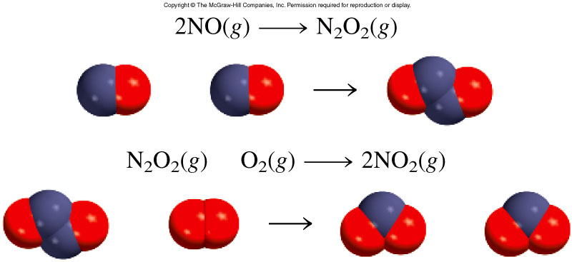
2NO (g) + O₂ (g) 2NO₂ (g)
13.5

Slide 54
Intermediates are species that appear in a reaction mechanism but not in the overall balanced equation.
An intermediate is always formed in an early elementary step and consumed in a later elementary step.
Elementary step:
NO + NO N₂O₂
+
Elementary step:
N₂O₂ + O₂ 2NO₂
Overall reaction:
2NO + O₂ 2NO₂
The molecularity of a reaction is the number of molecules reacting in an elementary step.
Unimolecular reaction – elementary step with 1 molecule
Bimolecular reaction – elementary step with 2 molecules
Termolecular reaction – elementary step with 3 molecules
13.5

Slide 55
Rate Laws and Elementary Steps ( add to sheet sheet)
Unimolecular reaction
A products
rate = k [A]
Bimolecular reaction
A + B products
rate = k [A][B]
Bimolecular reaction
A + A products
rate = k [A]²
Writing plausible reaction mechanisms:
The sum of the elementary steps must give the overall balanced equation for the reaction.
The rate-determining step should predict the same rate law that is determined experimentally.
The rate-determining step is the slowest step in the sequence of steps leading to product formation.
13.5

Slide 56
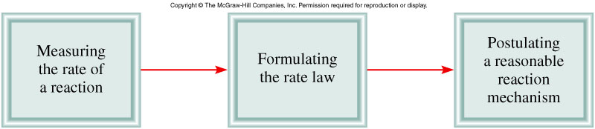
Sequence of Steps in Studying a Reaction Mechanism
13.5

Slide 57
The experimental rate law for the reaction between NO₂ and CO to produce NO and CO₂ is rate = k[NO₂]². The reaction is believed to occur via two steps:
Step 1:
NO₂ + NO₂ NO + NO₃
Step 2:
NO₃ + CO NO₂ + CO₂
What is the equation for the overall reaction?
NO₂+ CO NO + CO₂
What is the intermediate?
NO₃
What can you say about the relative rates of steps 1 and 2?
rate = k[NO₂]² is the rate law for step 1 so
step 1 must be slower than step 2
13.5

Slide 58
Try one
2A+2B → C + D Rate = k[A]²[B]
A+A → X fast
X + B → C+Y slow (rate determining step)
Y +B –> D fast
Prove the mechanism is constant with the rate law.
Rate for line 2 = Rate = k[X][B]
X is an intermediate (cancels out) X is really = to [A][A] or [A]² for [X]. That gives
Rate = k[A]²[B]

Slide 59
AP Question
The rate law for the overall reaction below is:
Rate = k[NO] [Cl₂]
i. NO + Cl₂ → NOCl₂
ii.NOCl₂ +NO →2NOCl
NO + Cl₂ →2NOCl
1. Is NOCl₂ an intermediate or a catalyst?
2. What step is faster?
3.What step determines the over all reaction rate and why?

Slide 60
The rate law for the overall reaction below is:
Rate = k[NO] + [Cl₂]
i. NO + Cl₂ → NOCl₂
ii.NOCl₂ +NO →2NOCl
NO + Cl₂ →2NOCl
1.Is NOCl₂ an intermediate or a catalyst?
Intermediate because it is produced in one reaction and consumed in another.

Slide 61
The rate law for the overall reaction below is:
Rate = k[NO] + [Cl₂]
i. NO + Cl₂ → NOCl₂
ii.NOCl₂ +NO →2NOCl
NO + Cl₂ →2NOCl
2. What step is faster?
Step ii
3.What step determines the over all reaction rate and why?
Step i because it determines the rate law.
NO + Cl₂ → NOCl₂
Rate = k[NO] + [Cl₂]

Slide 62
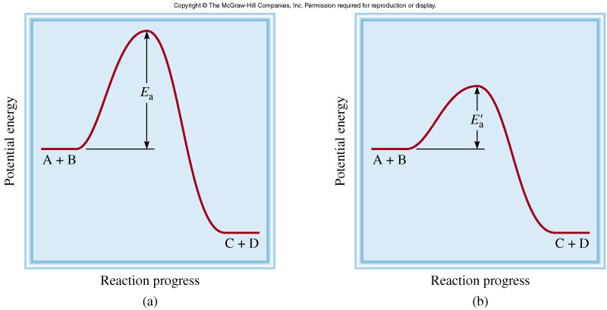
A catalyst is a substance that increases the rate of a chemical reaction without itself being consumed.
E_{a}
k
Uncatalyzed
Catalyzed
rate_{catalyzed} > rate_{uncatalyzed}
‘
E_{a} < E_{a}
13.6

Slide 63
Homework
Pg 602
21, 22, 23, 27
PR Problems – any 2
Essay – any 1

